Slide 1


22AIE113 Elements of Computing -2
Compiler I
Department of Computer Science & Engineering,
Amrita School of Engineering
Amrita Vishwa Vidyapeetham
Notes:
https://www.amrita.edu/news/amrita-surya-vahini-solar-auto-rickshaw

Slide 2





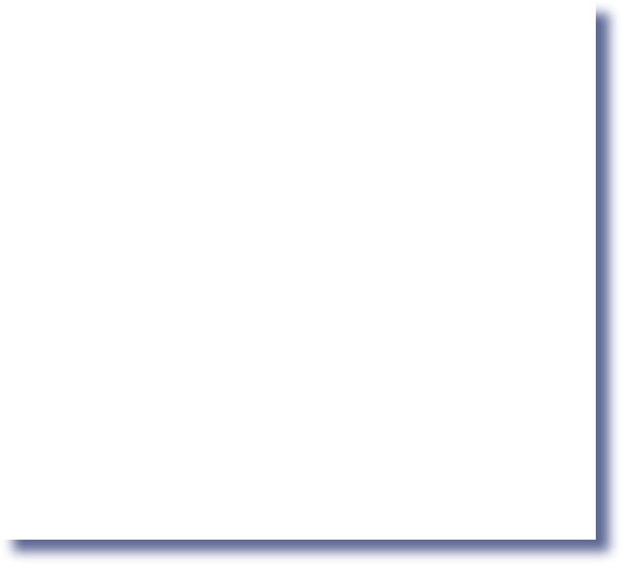

The big picture: compilation
high-level program machine code
0000000000010000
1110111111001000
0000000000010001
1110101010001000
0000000000010000
1111110000010000
0000000000000000
class Main {
function void main() { var Point p1, p2, p3;
let p1 = Point.new(1,2); let p2 = Point.new(3,4); let p3 = p1.plus(p2);
do p3.print();
// should print (4,6)
do Output.println();
Compiler
1111010011010 _{execute}
0000000000010010
1110001100000001
0000000000010000
1111110000010000
0000000000010001
0000000000010000
1110111111001000
0000000000010001
1110101010001000
0000000000010000
1111110000010000
0000000000000000
1111010011010000
0000000000010010
1110001100000001
0000000000010000
1111110000010000
0000000000010001
...
do Output.printInt(p1.distance(p3));
// should print 5
return;
}
/** Represents a Point. */
class Point {
}
field int x, y;
static int pointCount;
/** Constructs a new point */
constructor Point new(int ax,
int ay) {
let x = ax; let y = ay;
let pointCount =
pointCount + 1; return this;
}
// ... more Point methods
Nand to Tetris / www.nand2tetris.org / Chapter 6 / Copyright © Noam Nisan and Shimon Schocken

Slide 3





Two-tier compilation
high-level program
VM code
machine code
class Main {
function void main() { var Point p1, p2, p3;
let p1 = Point.new(1,2); let p2 = Point.new(3,4); let p3 = p1.plus(p2);
do p3.print();
// should print (4,6)
do Output.println();
push local 0
push constant 0 eq
not
push argument 1 neg
0000000000010000
1110111111001000
0000000000010001
1110101010001000
0000000000010000
1111110000010000
0000000000000000
1111010011010000
0000000000010010
1110001100000001
0000000000010000
1111110000010000
0000000000010001
0000000000010000
1110111111001000
0000000000010001
1110101010001000
0000000000010000
1111110000010000
0000000000000000
1111010011010000
0000000000010010
1110001100000001
0000000000010000
1111110000010000
0000000000010001
...
Compiler
^{push l} VM translator
call div
pop argument 3
push local 1 neg
push local 0
push local 1
push local 2 add
push constant 2
push local 0
pop argument 1
push local 0
push constant 0 not
push local 1
push local 0
push local 1 add
...
do Output.printInt(p1.distance(p3));
// should print 5
return;
}
/** Represents a Point. */
class Point {
}
field int x, y;
static int pointCount;
/** Constructs a new point */
constructor Point new(int ax,
int ay) {
let x = ax; let y = ay;
let pointCount =
pointCount + 1; return this;
}
// ... more Point methods
Reference: http://nand2tetris.org
Nand to Tetris / www.nand2tetris.org / Chapter 6 / Copyright © Noam Nisan and Shimon Schocken

Slide 4
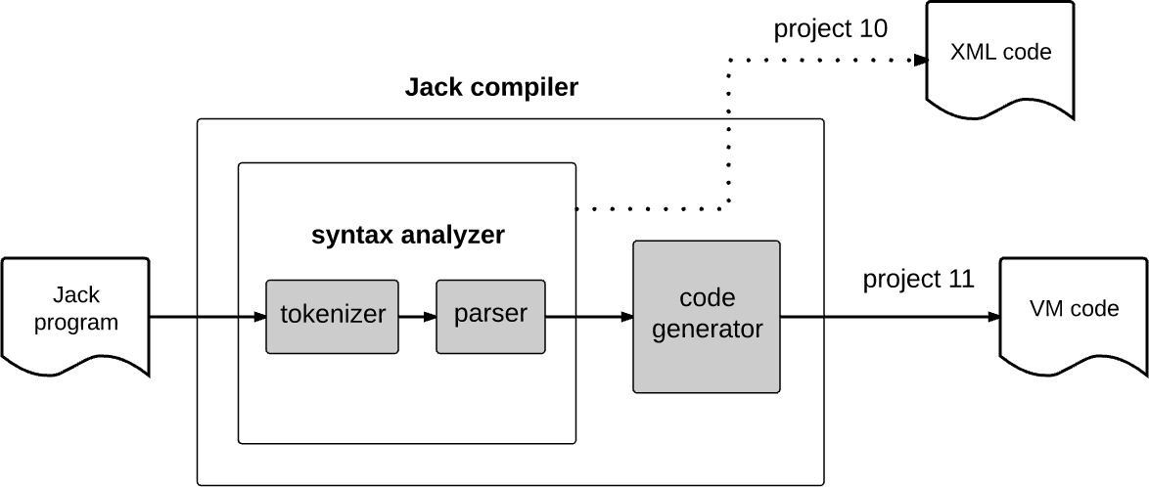


Compiler development roadmap
this chapter
Syntax analyzer implementation:
Tokenizer
Parser / compilation engine
Nand to Tetris / www.nand2tetris.org / Chapter 6 / Copyright © Noam Nisan and Shimon Schocken

Slide 5
Take home lessons
Tokenizing
Grammars
Parsing
Parse trees
XML / mark-up
Handling structured data files
Compilation.
Reference: http://nand2tetris.org
Nand to Tetris / www.nand2tetris.org / Chapter 6 / Copyright © Noam Nisan and Shimon Schocken

Slide 6
Compiler I / parsing: lecture plan
Parsing:
Parsing Jack programs
Overview
Tokenizer
Grammar
Parse trees
Parsing process
The Jack grammar
The Jack analyzer
Overview
Proposed implementation
Building the Jack Analyzer
Reference: http://nand2tetris.org
Nand to Tetris / www.nand2tetris.org / Chapter 6 / Copyright © Noam Nisan and Shimon Schocken

Slide 7


Compiler development roadmap
Reference: http://nand2tetris.org
Nand to Tetris / www.nand2tetris.org / Chapter 6 / Copyright © Noam Nisan and Shimon Schocken

Slide 8




Tokenizing (first approximation)
Prog.jack (input)
tokenized input
...
if (x < 0) {
// prints the sign let sign = "negative";
}
...
...
if
(
x
< 0
{
let sign
=
"negative"
;
}
...
tokenizing
compiler
stream of characters
stream of tokens
Tokenizing = grouping characters into tokens
A token is a string of characters that has a meaning
A programming language specification must document (among other things) its allowable tokens.
Nand to Tetris / www.nand2tetris.org / Chapter 10 / Copyright © Noam Nisan and Shimon Schocken
Nand to Tetris / www.nand2tetris.org / Chapter 6 / Copyright © Noam Nisan and Shimon Schocken

Slide 9
Jack tokens
Prog.jack (input)
...
if (x < 0) {
// prints the sign let sign = "negative";
}
...
keywords
symbols
integers
strings
identifiers
Reference: http://nand2tetris.org
Nand to Tetris / www.nand2tetris.org / Chapter 6 / Copyright © Noam Nisan and Shimon Schocken

Slide 10
Jack tokens
Prog.jack (input)
...
if (x < 0) {
// prints the sign let sign = "negative";
}
...
keyword: 'class' | 'constructor' | 'function' | 'method' | 'field' | 'static' | 'var' | 'int' | 'char' | 'boolean' | 'void' | 'true' | 'false' | 'null' | 'this' | 'let' | 'do' | 'if' | 'else' | 'while' | 'return’
symbol: '{' | '}' | '(' | ')' | '[' | ']' | '. ' | ', ' | '; ' | '+' | '-' | '*' | '/' | '&' | '|' | '<' | '>' | '=' | '~'
integerConstant: a decimal number in the range 0 ... 32767 StringConstant: '"' a sequence of Unicode characters,
not including double quote or newline '"'
identifier: a sequence of letters, digits, and underscore ( '_' ) not starting with a digit.
Reference: http://nand2tetris.org
Nand to Tetris / www.nand2tetris.org / Chapter 6 / Copyright © Noam Nisan and Shimon Schocken

Slide 11


Jack tokenizer
Prog.jack
...
if (x < 0) {
// prints the sign let sign = "negative";
output
...
<keyword> if </keyword>
<symbol> ( </symbol>
<identifier> x </identifier>
<symbol> < </symbol>
<intConst> 0 </intCons>
<symbol> ) </symbol>
<symbol> { </symbol>
<keyword> let </keyword>
<identifier> sign </identifier>
<symbol> = </symbol>
<stringConst> negative </stringConst>
<symbol> ; </symbol>
<symbol> } </symbol>
...
}
...
TokenizerTest
keyword: 'class' | 'constructor' | 'function' | 'method' | 'field' | 'static' | 'var' | 'int' | 'char' | 'boolean' | 'void' | 'true' | 'false' | 'null' | 'this' | 'let' | 'do' | 'if' | 'else' | 'while' | 'return’
symbol: '{' | '}' | '(' | ')' | '[' | ']' | '. ' | ', ' | '; ' | '+' | '-' | '*' | '/' | '&' | '|' | '<' | '>' | '=' | '~'
integerConstant: a decimal number in the range 0 ... 32767 StringConstant: '"' a sequence of Unicode characters,
not including double quote or newline '"'
identifier: a sequence of letters, digits, and underscore ( '_' ) not starting with a digit.
Tokenizer:
Handles the compiler’s input
Allows advancing the input
Supplies the current token’s value and type
(complete API, later)
Reference: http://nand2tetris.org
Nand to Tetris / www.nand2tetris.org / Chapter 10 / Copyright © Noam Nisan and Shimon Schocken
Nand to Tetris / www.nand2tetris.org / Chapter 6 / Copyright © Noam Nisan and Shimon Schocken

Slide 12


Jack tokenizer
Prog.jack
...
if (x < 0) {
// prints the sign let sign = "negative";
output
...
<keyword> if </keyword>
<symbol> ( </symbol>
<identifier> x </identifier>
<symbol> < </symbol>
<intConst> 0 </intCons>
<symbol> ) </symbol>
<symbol> { </symbol>
<keyword> let </keyword>
<identifier> sign </identifier>
<symbol> = </symbol>
<stringConst> negative </stringConst>
<symbol> ; </symbol>
<symbol> } </symbol>
...
}
...
TokenizerTest
TokenizerTest (pseudo code)
tknzr = new JackTokenizer("Prog.jack") tknzr.advance();
while tknzr.hasMoreTokens() { tokenClassification = current token
classification
print "<" + tokenClassification + ">"
print the current token value
print "</" + tokenClassification + ">"
print newLine tknzr.advance();
}
Tokenizer:
Handles the compiler’s input
Allows advancing the input
Supplies the current token’s value and type
(complete API, later)
Reference: http://nand2tetris.org
Nand to Tetris / www.nand2tetris.org / Chapter 10 / Copyright © Noam Nisan and Shimon Schocken
Nand to Tetris / www.nand2tetris.org / Chapter 6 / Copyright © Noam Nisan and Shimon Schocken

Slide 13
Compiler development roadmap
Reference: http://nand2tetris.org
Nand to Tetris / www.nand2tetris.org / Chapter 6 / Copyright © Noam Nisan and Shimon Schocken

Slide 14
Compiler development roadmap
Reference: http://nand2tetris.org
Nand to Tetris / www.nand2tetris.org / Chapter 6 / Copyright © Noam Nisan and Shimon Schocken

Slide 15
Compiler I / parsing: lecture plan
Parsing:
Parsing Jack programs
Overview
Tokenizer
Grammar
Parse trees
Parsing process
The Jack grammar
The Jack analyzer
Overview
Proposed implementation
Building the Jack Analyzer
Reference: http://nand2tetris.org
Nand to Tetris / www.nand2tetris.org / Chapter 6 / Copyright © Noam Nisan and Shimon Schocken

Slide 16


Tokenizing (reminder)
source code
tokenized code
/** Represents a Point. */ class Point {
...
/** Constructs a new point */ constructor Point new(int ax,
int ay) {
let x = ax; let y = ay;
let pointCount = pointCount + 1; return this;
<keyword> class </keyword>
<identifier> Point </identifier>
<symbol> { </symbol>
...
<keyword> constructor </keyword>
<identifier> Point </identifier>
<identifier> new </identifier>
<symbol> ( </symbol>
<keyword> int </keyword>
<identifier> ax </identifier>
<symbol> , </symbol>
<keyword> int </keyword>
<identifier> ay </identifier>
<symbol> ) </symbol>
<symbol> { </symbol>
... // tokenizing the next two statements (omitted)
<keyword> let </keyword>
<identifier> pointCount </identifier>
<symbol> = </symbol>
<identifier> pointCount </identifier>
<symbol> + </symbol>
<integerConstant> 1 </integerConstant>
<symbol> ; </symbol>
...
}
...
tokenizer
}
Reference: http://nand2tetris.org
Nand to Tetris / www.nand2tetris.org / Chapter 6 / Copyright © Noam Nisan and Shimon Schocken

Slide 17




Grammar
A grammar is a set of rules, describing how tokens can be combined to create valid language constructs
sentence: nounPhrase: verbPhrase:
noun: verb:
nounPhrase verbPhrase determiner ? noun
verb nounPhrase
Each rule has a left side and a right side
'dog' | ’school' | 'dina' | ’he' | ’she' | 'homework’ | ...
'went' | 'ate' | ’said' | ...
determiner:
. . .
'the' | 'to' | 'my’ | ...
Dina went to school
She said
The dog ate my homework
Terminal rule: right-hand side includes
constants only
Non-terminal rule: all other rules
Reference: http://nand2tetris.org
Nand to Tetris / www.nand2tetris.org / Chapter 6 / Copyright © Noam Nisan and Shimon Schocken

Slide 18

Grammar
Jack grammar (subset)
statement: ifStatement |
whileStatement | letStatement
Reference: http://nand2tetris.org
Nand to Tetris / www.nand2tetris.org / Chapter 6 / Copyright © Noam Nisan and Shimon Schocken

Slide 19




Grammar
Jack grammar (subset)
Input examples
statement: ifStatement |
whileStatement | letStatement
statements: statement* ifStatement: 'if' '(' expression ')’
'{' statements '}’
whileStatement: 'while' '(' expression ')’
'{' statements '}’
letStatement: 'let' varName '=' expression ';' expression: term (op term)?
term: varName | constant
varName: a string not beginning with a digit constant: a decimal number
op: '+' | '-' | '=' | '>' | '<'
Expressions
17
x
x + 17
x - y
Nand to Tetris / www.nand2tetris.org / Chapter 6 / Copyright © Noam Nisan and Shimon Schocken

Slide 20


Grammar
Jack grammar (subset)
Input examples
statement: ifStatement |
whileStatement | letStatement
statements: statement* ifStatement: 'if' '(' expression ')’
'{' statements '}’
whileStatement: 'while' '(' expression ')’
'{' statements '}’
letStatement: 'let' varName '=' expression ';' expression: term (op term)?
term: varName | constant
varName: a string not beginning with a digit constant: a decimal number
op: '+' | '-' | '=' | '>' | '<'
let x = 100;
Nand to Tetris / www.nand2tetris.org / Chapter 10 / Copyright © Noam Nisan and Shimon Schocken
Nand to Tetris / www.nand2tetris.org / Chapter 6 / Copyright © Noam Nisan and Shimon Schocken

Slide 21

Grammar
Jack grammar (subset)
Input examples
statement: ifStatement |
whileStatement | letStatement
statements: statement* ifStatement: 'if' '(' expression ')’
'{' statements '}’
whileStatement: 'while' '(' expression ')’
'{' statements '}’
letStatement: 'let' varName '=' expression ';' expression: term (op term)?
term: varName | constant
varName: a string not beginning with a digit constant: a decimal number
op: '+' | '-' | '=' | '>' | '<'
let x = 100;
let x = x + 1;
Nand to Tetris / www.nand2tetris.org / Chapter 6 / Copyright © Noam Nisan and Shimon Schocken

Slide 22



Grammar
Jack grammar (subset)
Input examples
statement: ifStatement |
whileStatement | letStatement
statements: statement* ifStatement: 'if' '(' expression ')’
'{' statements '}’
whileStatement: 'while' '(' expression ')’
'{' statements '}’
letStatement: 'let' varName '=' expression ';' expression: term (op term)?
term: varName | constant
varName: a string not beginning with a digit constant: a decimal number
op: '+' | '-' | '=' | '>' | '<'
let x = 100;
let x = x + 1;
while (n < lim) let n = n + 1;
}
Nand to Tetris / www.nand2tetris.org / Chapter 6 / Copyright © Noam Nisan and Shimon Schocken

Slide 23


Grammar
Jack grammar (subset)
Input examples
statement: ifStatement |
whileStatement | letStatement
statements: statement* ifStatement: 'if' '(' expression ')’
'{' statements '}’
whileStatement: 'while' '(' expression ')’
'{' statements '}’
letStatement: 'let' varName '=' expression ';' expression: term (op term)?
term: varName | constant
varName: a string not beginning with a digit constant: a decimal number
op: '+' | '-' | '=' | '>' | '<'
let x = 100;
let x = x + 1;
while (n < lim) let n = n + 1;
}
if (x = 1) { let x = 100;
let x = x + 1;
}
Nand to Tetris / www.nand2tetris.org / Chapter 6 / Copyright © Noam Nisan and Shimon Schocken

Slide 24


Grammar
Jack grammar (subset)
Input examples
statement: ifStatement |
whileStatement | letStatement
statements: statement* ifStatement: 'if' '(' expression ')’
'{' statements '}’
whileStatement: 'while' '(' expression ')’
'{' statements '}’
letStatement: 'let' varName '=' expression ';' expression: term (op term)?
term: varName | constant
varName: a string not beginning with a digit constant: a decimal number
op: '+' | '-' | '=' | '>' | '<'
while (lim < 100) { if (x = 1) {
let z = 100; while (z > 0) {
let z = z – 1;
}
}
let lim = lim + 10;
}
Parsing:
Determining if a given input conforms to a grammar
In the process, uncovering the grammatical structure of the given input.
Nand to Tetris / www.nand2tetris.org / Chapter 6 / Copyright © Noam Nisan and Shimon Schocken

Slide 25
Compiler I / parsing: lecture plan
Parsing:
Parsing Jack programs
Overview
Tokenizer
Grammar
Parse trees
Parsing process
The Jack grammar
The Jack analyzer
Overview
Proposed implementation
Building the Jack Analyzer
Reference: http://nand2tetris.org
Nand to Tetris / www.nand2tetris.org / Chapter 6 / Copyright © Noam Nisan and Shimon Schocken

Slide 26


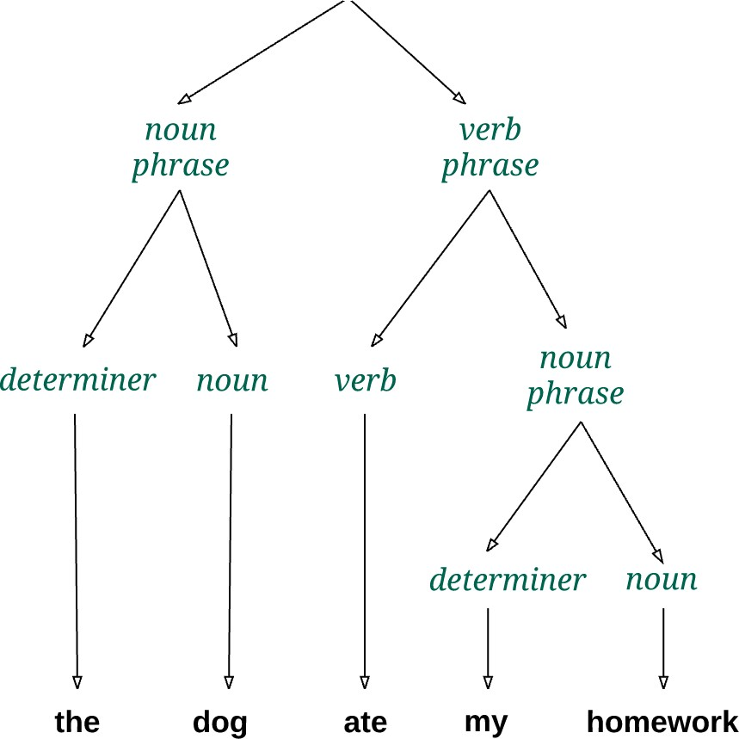

Parse tree
sentence: nounPhrase verbPhrase
nounPhrase: determiner ? noun verbPhrase: verb nounPhrase
noun: 'dog' | ’school' | 'dina' |
’he' | ’she' | 'homework’ | ...
verb: 'went' | 'ate' | ’said' | ...
determiner: 'the' | 'to' | 'my’ | ...
. . .
Parsing
Determine if the given input conforms to the grammar
In the process, construct the grammatical structure of the input
input
Nand to Tetris / www.nand2tetris.org / Chapter 6 / Copyright © Noam Nisan and Shimon Schocken

Slide 27


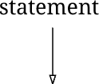
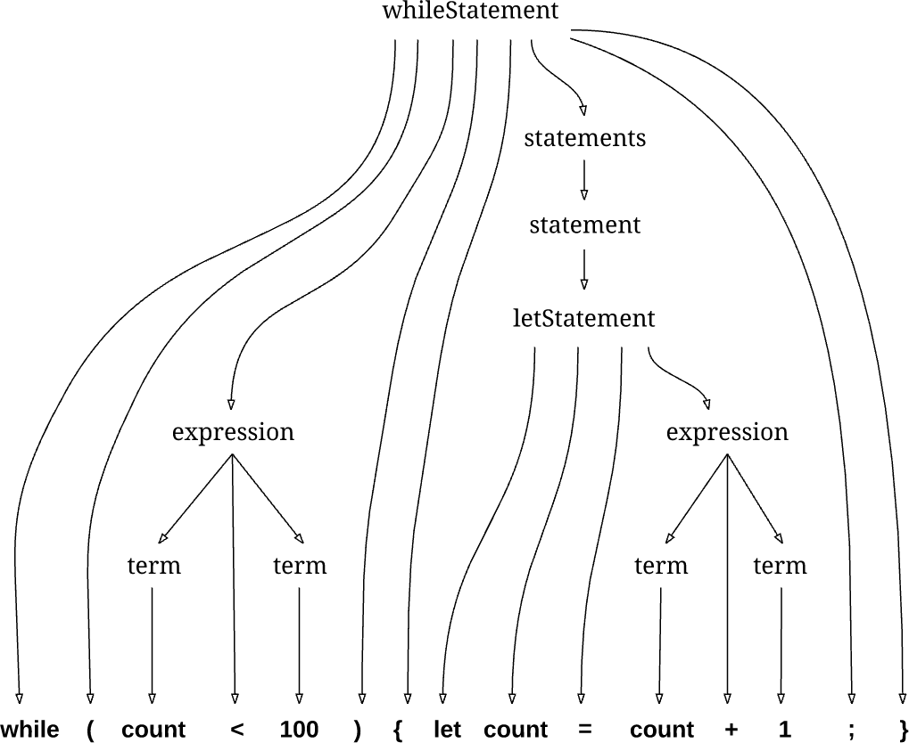

Parse tree: Jack
statement:
ifStatement | whileStatement | letStatement
statement*
'if' '(' expression ')’
'{' statements '}’
grammar
statements: ifStatement:
whileStatement: 'while' '(' expression ')’
'{' statements '}’
letStatement: 'let' varName '=' expression ';' expression: term (op term)?
term: varName | constant varName: a string not beg. with a digit
constant: a decimal number op: '+' | '-' | '=' | '>' | '<'
input
Nand to Tetris / www.nand2tetris.org / Chapter 10 / Copyright © Noam Nisan and Shimon Schocken
Nand to Tetris / www.nand2tetris.org / Chapter 6 / Copyright © Noam Nisan and Shimon Schocken

Slide 28
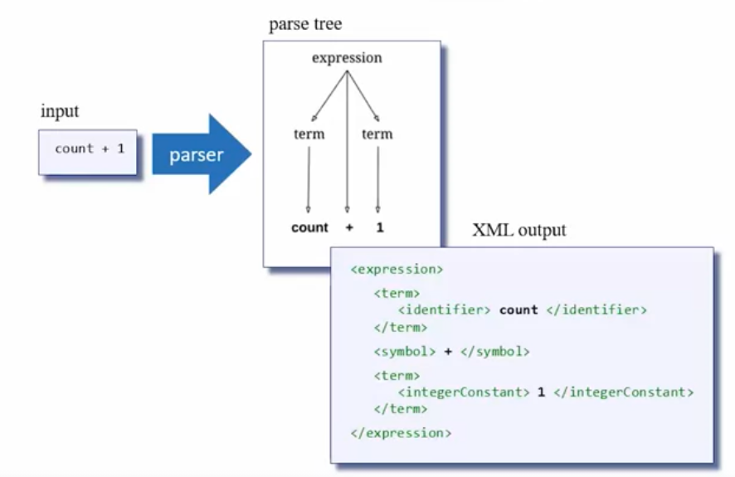
Parse tree : Jack
Nand to Tetris / www.nand2tetris.org / Chapter 10 / Copyright © Noam Nisan and Shimon Schocken
Nand to Tetris / www.nand2tetris.org / Chapter 6 / Copyright © Noam Nisan and Shimon Schocken

Slide 29


Parse tree: Jack
statement:
ifStatement | whileStatement | letStatement
statement*
'if' '(' expression ')’
'{' statements '}’
grammar
<whileStatement>
<keyword> while </keyword>
<symbol> ( </symbol>
<expression>
<term>
<identifier> count </identifier>
</term>
<symbol> < </symbol>
<term>
<intConstant> 100 </intConstant>
</term>
</expression>
<symbol> ) </symbol>
<symbol> { </symbol>
<statements>
<letStatement>
<keyword> let </keyword>
<identifier> count </identifier>
<symbol> = </symbol>
<expression>
parser output
statements: ifStatement:
whileStatement: 'while' '(' expression ')’
'{' statements '}’
letStatement: 'let' varName '=' expression ';' expression: term (op term)?
term: varName | constant varName: a string not beg. with a digit
constant: a decimal number op: '+' | '-' | '=' | '>' | '<'
Same parse tree, in XML
<term> <identifier> count </identifier> </term>
<symbol> + </symbol>
<term> <intConstant> 1 </intConstant> </term>
</expression>
<symbol> ; </symbol>
</letStatement>
</statements>
<symbol> } </symbol>
</whileStatement>
Nand to Tetris / www.nand2tetris.org / Chapter 6 / Copyright © Noam Nisan and Shimon Schocken

Slide 30
Compiler I / parsing: lecture plan
Parsing:
Parsing Jack programs
Overview
Tokenizer
Grammar
Parse trees
Parsing process
The Jack grammar
The Jack analyzer
Overview
Proposed implementation
Building the Jack Analyzer
Reference: http://nand2tetris.org
Nand to Tetris / www.nand2tetris.org / Chapter 6 / Copyright © Noam Nisan and Shimon Schocken

Slide 31


Parser design (sneak preview)
statement:
ifStatement | whileStatement | letStatement
statement*
'if' '(' expression ')’
'{' statements '}’
grammar
Parser
statements: ifStatement:
class CompilationEngine {
compileStatements() {
// code for compiling statements
}
compileIfStatement() {
// code for compiling an if statement
}
compileWhileStatement() {
// code for compiling an while statement
}
...
compileTerm() {
// code for compiling a term
}
}
whileStatement:
'while' '(' expression ')’
'{' statements '}’
'let' varName '=' expression ';' term (op term)?
varName | constant
a string not beg. with a digit a decimal number
'+' | '-' | '=' | '>' | '<'
letStatement: expression:
term: varName: constant:
op:
The parser conists of a set of
compilexxx methods;
each compilexxx method implements the right hand side of the grammar rule describing xxx
Nand to Tetris / www.nand2tetris.org / Chapter 6 / Copyright © Noam Nisan and Shimon Schocken

Slide 32
Parsing process
statement:
ifStatement | whileStatement | letStatement
statement*
'if' '(' expression ')’
'{' statements '}’
grammar
Parsing process
statements: ifStatement:
Follow the right-hand side of the rule, and parse the input accordingly
If the right-hand side specifies a non-terminal rule xxx, call compilexxx
Do this recursively.
whileStatement: 'while' '(' expression ')’
'{' statements '}’
letStatement: 'let' varName '=' expression ';' expression: term (op term)?
term: varName | constant varName: a string not beg. with a digit
constant: a decimal number op: '+' | '-' | '=' | '>' | '<'
Reference: http://nand2tetris.org
Nand to Tetris / www.nand2tetris.org / Chapter 6 / Copyright © Noam Nisan and Shimon Schocken

Slide 33
Parsing process
statement:
ifStatement | whileStatement | letStatement
statement*
'if' '(' expression ')’
'{' statements '}’
grammar
Parsing process
statements: ifStatement:
Follow the right-hand side of the rule, and parse the input accordingly
If the right-hand side specifies a non-terminal rule xxx, call compilexxx
Do this recursively.
whileStatement: 'while' '(' expression ')’
'{' statements '}’
letStatement: 'let' varName '=' expression ';' expression: term (op term)?
term: varName | constant varName: a string not beg. with a digit
constant: a decimal number op: '+' | '-' | '=' | '>' | '<'
Example:
Let us assume that we read while,
so we know that we have to call the method
compileWhileStatement
input
Nand to Tetris / www
Nand to Tetris / www.nand2tetris.org / Chapter 6 / Copyright © Noam Nisan and Shimon Schocken

Slide 34
Parsing process
compileWhileStatement
statement:
ifStatement | whileStatement | letStatement
statement*
'if' '(' expression ')’
'{' statements '}’
grammar
parser output
statements: ifStatement:
whileStatement: 'while' '(' expression ')’
'{' statements '}’
letStatement: 'let' varName '=' expression ';' expression: term (op term)?
term: varName | constant varName: a string not beg. with a digit
constant: a decimal number op: '+' | '-' | '=' | '>' | '<'
input
Nand to Tetris / www

Slide 35
Parsing process
compileWhileStatement
statement:
ifStatement | whileStatement | letStatement
statement*
'if' '(' expression ')’
'{' statements '}’
grammar
<whileStatement>
parser output
statements: ifStatement:
whileStatement: 'while' '(' expression ')’
'{' statements '}’
letStatement: 'let' varName '=' expression ';' expression: term (op term)?
term: varName | constant varName: a string not beg. with a digit
constant: a decimal number op: '+' | '-' | '=' | '>' | '<'
input
Nand to Tetris / www.nand2tetris.org / Chapter 6 / Copyright © Noam Nisan and Shimon Schocken

Slide 36
Parsing process
compileWhileStatement
statement:
ifStatement | whileStatement | letStatement
statement*
'if' '(' expression ')’
'{' statements '}’
grammar
<whileStatement>
parser output
<keyword> while </keyword>
statements: ifStatement:
whileStatement: 'while' '(' expression ')’
'{' statements '}’
letStatement: 'let' varName '=' expression ';' expression: term (op term)?
term: varName | constant varName: a string not beg. with a digit
constant: a decimal number op: '+' | '-' | '=' | '>' | '<'
input
Nand to Tetris / www
Nand to Tetris / www.nand2tetris.org / Chapter 6 / Copyright © Noam Nisan and Shimon Schocken

Slide 37
Parsing process
compileWhileStatement
statement:
ifStatement | whileStatement | letStatement
statement*
'if' '(' expression ')’
'{' statements '}’
grammar
<whileStatement>
parser output
<keyword> while </keyword>
statements: ifStatement:
whileStatement: 'while' '(' expression ')’
'{' statements '}’
letStatement: 'let' varName '=' expression ';' expression: term (op term)?
term: varName | constant varName: a string not beg. with a digit
constant: a decimal number op: '+' | '-' | '=' | '>' | '<'
input
Nand to Tetris / www.nand2tetris.org / Chapter 6 / Copyright © Noam Nisan and Shimon Schocken

Slide 38
Parsing process
compileWhileStatement
statement:
ifStatement | whileStatement | letStatement
statement*
'if' '(' expression ')’
'{' statements '}’
grammar
<whileStatement>
parser output
<keyword> while </keyword>
<symbol> ( </symbol>
statements: ifStatement:
whileStatement: 'while' '(' expression ')’
'{' statements '}’
letStatement: 'let' varName '=' expression ';' expression: term (op term)?
term: varName | constant varName: a string not beg. with a digit
constant: a decimal number op: '+' | '-' | '=' | '>' | '<'
input
Nand to Tetris / www.nand2tetris.org / Chapter 6 / Copyright © Noam Nisan and Shimon Schocken

Slide 39
Parsing process
compileWhileStatement
statement:
ifStatement | whileStatement | letStatement
statement*
'if' '(' expression ')’
'{' statements '}’
grammar
<whileStatement>
parser output
<keyword> while </keyword>
<symbol> ( </symbol>
statements: ifStatement:
whileStatement: 'while' '(' expression ')’
'{' statements '}’
letStatement: 'let' varName '=' expression ';' expression: term (op term)?
term: varName | constant varName: a string not beg. with a digit
constant: a decimal number op: '+' | '-' | '=' | '>' | '<'
input
Nand to Tetris / www.nand2tetris.org / Chapter 6 / Copyright © Noam Nisan and Shimon Schocken

Slide 40
Parsing process
compileWhileStatement
statement:
ifStatement | whileStatement | letStatement
statement*
'if' '(' expression ')’
'{' statements '}’
grammar
<whileStatement>
parser output
compileExpression
<keyword> while </keyword>
<symbol> ( </symbol>
<expression>
statements: ifStatement:
whileStatement: 'while' '(' expression ')’
'{' statements '}’
letStatement: 'let' varName '=' expression ';' expression: term (op term)?
term: varName | constant varName: a string not beg. with a digit
constant: a decimal number op: '+' | '-' | '=' | '>' | '<'
input
Nand to Tetris / www.nand2tetris.org / Chapter 6 / Copyright © Noam Nisan and Shimon Schocken

Slide 41
Parsing process
compileWhileStatement
statement:
ifStatement | whileStatement | letStatement
statement*
'if' '(' expression ')’
'{' statements '}’
grammar
<whileStatement>
parser output
compileExpression
compileTerm
<keyword> while </keyword>
<symbol> ( </symbol>
<expression>
<term>
statements: ifStatement:
whileStatement: 'while' '(' expression ')’
'{' statements '}’
letStatement: 'let' varName '=' expression ';' expression: term (op term)?
term: varName | constant varName: a string not beg. with a digit
constant: a decimal number op: '+' | '-' | '=' | '>' | '<'
input

Slide 42
Parsing process
compileWhileStatement
statement:
ifStatement | whileStatement | letStatement
statement*
'if' '(' expression ')’
'{' statements '}’
grammar
<whileStatement>
parser output
compileExpression
compileTerm
<keyword> while </keyword>
<symbol> ( </symbol>
<expression>
<term>
statements: ifStatement:
<identifier> count </identifier>
whileStatement: 'while' '(' expression ')’
'{' statements '}’
letStatement: 'let' varName '=' expression ';' expression: term (op term)?
term: varName | constant varName: a string not beg. with a digit
constant: a decimal number op: '+' | '-' | '=' | '>' | '<'
input
Nand to Tetris / www.nand2tetris.org / Chapter 6 / Copyright © Noam Nisan and Shimon Schocken

Slide 43
Parsing process
compileWhileStatement
statement:
ifStatement | whileStatement | letStatement
statement*
'if' '(' expression ')’
'{' statements '}’
grammar
<whileStatement>
parser output
compileExpression
compileTerm
<keyword> while </keyword>
<symbol> ( </symbol>
<expression>
<term>
statements: ifStatement:
<identifier> count </identifier>
whileStatement: 'while' '(' expression ')’
'{' statements '}’
letStatement: 'let' varName '=' expression ';' expression: term (op term)?
term: varName | constant varName: a string not beg. with a digit
constant: a decimal number op: '+' | '-' | '=' | '>' | '<'
input
Nand to Tetris / www.nand2tetris.org / Chapter 6 / Copyright © Noam Nisan and Shimon Schocken

Slide 44
Parsing process
compileWhileStatement
statement:
ifStatement | whileStatement | letStatement
statement*
'if' '(' expression ')’
'{' statements '}’
grammar
<whileStatement>
parser output
compileExpression
compileTerm
<keyword> while </keyword>
<symbol> ( </symbol>
<expression>
<term>
statements: ifStatement:
<identifier> count </identifier>
</term>
whileStatement: 'while' '(' expression ')’
'{' statements '}’
letStatement: 'let' varName '=' expression ';' expression: term (op term)?
term: varName | constant varName: a string not beg. with a digit
constant: a decimal number op: '+' | '-' | '=' | '>' | '<'
input
Nand to Tetris / www
Nand to Tetris / www.nand2tetris.org / Chapter 6 / Copyright © Noam Nisan and Shimon Schocken

Slide 45
Parsing process
compileWhileStatement
statement:
ifStatement | whileStatement | letStatement
statement*
'if' '(' expression ')’
'{' statements '}’
grammar
<whileStatement>
parser output
compileExpression
compileTerm
<keyword> while </keyword>
<symbol> ( </symbol>
<expression>
<term>
statements: ifStatement:
<identifier> count </identifier>
</term>
whileStatement: 'while' '(' expression ')’
'{' statements '}’
letStatement: 'let' varName '=' expression ';' expression: term (op term)?
term: varName | constant varName: a string not beg. with a digit
constant: a decimal number op: '+' | '-' | '=' | '>' | '<'
input
Nand to Tetris / www
Nand to Tetris / www.nand2tetris.org / Chapter 6 / Copyright © Noam Nisan and Shimon Schocken

Slide 46
Parsing process
compileWhileStatement
statement:
ifStatement | whileStatement | letStatement
statement*
'if' '(' expression ')’
'{' statements '}’
grammar
<whileStatement>
parser output
compileExpression
compileTerm
<keyword> while </keyword>
<symbol> ( </symbol>
<expression>
<term>
statements: ifStatement:
<identifier> count </identifier>
</term>
<symbol> < </symbol>
whileStatement: 'while' '(' expression ')’
'{' statements '}’
letStatement: 'let' varName '=' expression ';' expression: term (op term)?
term: varName | constant varName: a string not beg. with a digit
constant: a decimal number op: '+' | '-' | '=' | '>' | '<'
input
Nand to Tetris / www
Nand to Tetris / www.nand2tetris.org / Chapter 6 / Copyright © Noam Nisan and Shimon Schocken

Slide 47
Parsing process
compileWhileStatement
statement:
ifStatement | whileStatement | letStatement
statement*
'if' '(' expression ')’
'{' statements '}’
grammar
<whileStatement>
parser output
compileExpression
compileTerm
<keyword> while </keyword>
<symbol> ( </symbol>
<expression>
<term>
statements: ifStatement:
<identifier> count </identifier>
</term>
<symbol> < </symbol>
whileStatement: 'while' '(' expression ')’
'{' statements '}’
letStatement: 'let' varName '=' expression ';' expression: term (op term)?
term: varName | constant varName: a string not beg. with a digit
constant: a decimal number op: '+' | '-' | '=' | '>' | '<'
input
Nand to Tetris / www
Nand to Tetris / www.nand2tetris.org / Chapter 6 / Copyright © Noam Nisan and Shimon Schocken

Slide 48
Parsing process
compileWhileStatement
statement:
ifStatement | whileStatement | letStatement
statement*
'if' '(' expression ')’
'{' statements '}’
grammar
<whileStatement>
parser output
compileExpression
compileTerm
<keyword> while </keyword>
<symbol> ( </symbol>
<expression>
<term>
statements: ifStatement:
<identifier> count </identifier>
</term>
whileStatement: 'while' '(' expression ')’
'{' statements '}’
letStatement: 'let' varName '=' expression ';' expression: term (op term)?
term: varName | constant varName: a string not beg. with a digit
constant: a decimal number op: '+' | '-' | '=' | '>' | '<'
<symbol> < </symbol>
<term>
compileTerm
input
Nand to Tetris / www
Nand to Tetris / www.nand2tetris.org / Chapter 6 / Copyright © Noam Nisan and Shimon Schocken

Slide 49
Parsing process
compileWhileStatement
statement:
ifStatement | whileStatement | letStatement
statement*
'if' '(' expression ')’
'{' statements '}’
grammar
<whileStatement>
parser output
compileExpression
compileTerm
<keyword> while </keyword>
<symbol> ( </symbol>
<expression>
<term>
statements: ifStatement:
<identifier> count </identifier>
</term>
whileStatement: 'while' '(' expression ')’
'{' statements '}’
letStatement: 'let' varName '=' expression ';' expression: term (op term)?
term: varName | constant varName: a string not beg. with a digit
constant: a decimal number op: '+' | '-' | '=' | '>' | '<'
<symbol> < </symbol>
<term>
compileTerm
<intConstant> 100 </intConstant>
input
Nand to Tetris / www
Nand to Tetris / www.nand2tetris.org / Chapter 6 / Copyright © Noam Nisan and Shimon Schocken

Slide 50
Parsing process
compileWhileStatement
statement:
ifStatement | whileStatement | letStatement
statement*
'if' '(' expression ')’
'{' statements '}’
grammar
<whileStatement>
parser output
compileExpression
compileTerm
<keyword> while </keyword>
<symbol> ( </symbol>
<expression>
<term>
statements: ifStatement:
<identifier> count </identifier>
</term>
whileStatement: 'while' '(' expression ')’
'{' statements '}’
letStatement: 'let' varName '=' expression ';' expression: term (op term)?
term: varName | constant varName: a string not beg. with a digit
constant: a decimal number op: '+' | '-' | '=' | '>' | '<'
<symbol> < </symbol>
<term>
compileTerm
<intConstant> 100 </intConstant>
input
Nand to Tetris / www
Nand to Tetris / www.nand2tetris.org / Chapter 6 / Copyright © Noam Nisan and Shimon Schocken

Slide 51
Parsing process
compileWhileStatement
statement:
ifStatement | whileStatement | letStatement
statement*
'if' '(' expression ')’
'{' statements '}’
grammar
<whileStatement>
parser output
compileExpression
compileTerm
<keyword> while </keyword>
<symbol> ( </symbol>
<expression>
<term>
statements: ifStatement:
<identifier> count </identifier>
</term>
whileStatement: 'while' '(' expression ')’
'{' statements '}’
letStatement: 'let' varName '=' expression ';' expression: term (op term)?
term: varName | constant varName: a string not beg. with a digit
constant: a decimal number op: '+' | '-' | '=' | '>' | '<'
<symbol> < </symbol>
<term>
compileTerm
<intConstant> 100 </intConstant>
</term>
input
Nand to Tetris / www
Nand to Tetris / www.nand2tetris.org / Chapter 6 / Copyright © Noam Nisan and Shimon Schocken

Slide 52
Parsing process
compileWhileStatement
statement:
ifStatement | whileStatement | letStatement
statement*
'if' '(' expression ')’
'{' statements '}’
grammar
<whileStatement>
parser output
compileExpression
compileTerm
<keyword> while </keyword>
<symbol> ( </symbol>
<expression>
<term>
statements: ifStatement:
<identifier> count </identifier>
</term>
whileStatement: 'while' '(' expression ')’
'{' statements '}’
letStatement: 'let' varName '=' expression ';' expression: term (op term)?
term: varName | constant varName: a string not beg. with a digit
constant: a decimal number op: '+' | '-' | '=' | '>' | '<'
<symbol> < </symbol>
<term>
compileTerm
<intConstant> 100 </intConstant>
</term>
input
Nand to Tetris / www
Nand to Tetris / www.nand2tetris.org / Chapter 6 / Copyright © Noam Nisan and Shimon Schocken

Slide 53
Parsing process
compileWhileStatement
statement:
ifStatement | whileStatement | letStatement
statement*
'if' '(' expression ')’
'{' statements '}’
grammar
<whileStatement>
parser output
compileExpression
compileTerm
<keyword> while </keyword>
<symbol> ( </symbol>
<expression>
<term>
statements: ifStatement:
<identifier> count </identifier>
</term>
whileStatement: 'while' '(' expression ')’
'{' statements '}’
letStatement: 'let' varName '=' expression ';' expression: term (op term)?
term: varName | constant varName: a string not beg. with a digit
constant: a decimal number op: '+' | '-' | '=' | '>' | '<'
<symbol> < </symbol>
<term>
compileTerm
<intConstant> 100 </intConstant>
</term>
</expression>
input
Nand to Tetris / www
Nand to Tetris / www.nand2tetris.org / Chapter 6 / Copyright © Noam Nisan and Shimon Schocken

Slide 54
Parsing process
compileWhileStatement
statement:
ifStatement | whileStatement | letStatement
statement*
'if' '(' expression ')’
'{' statements '}’
grammar
<whileStatement>
parser output
compileExpression
compileTerm
<keyword> while </keyword>
<symbol> ( </symbol>
<expression>
<term>
statements: ifStatement:
<identifier> count </identifier>
</term>
whileStatement: 'while' '(' expression ')’
'{' statements '}’
letStatement: 'let' varName '=' expression ';' expression: term (op term)?
term: varName | constant varName: a string not beg. with a digit
constant: a decimal number op: '+' | '-' | '=' | '>' | '<'
<symbol> < </symbol>
<term>
compileTerm
<intConstant> 100 </intConstant>
</term>
</expression>
input
Nand to Tetris / www
Nand to Tetris / www.nand2tetris.org / Chapter 6 / Copyright © Noam Nisan and Shimon Schocken

Slide 55
Parsing process
compileWhileStatement
statement:
ifStatement | whileStatement | letStatement
statement*
'if' '(' expression ')’
'{' statements '}’
grammar
<whileStatement>
parser output
compileExpression
compileTerm
<keyword> while </keyword>
<symbol> ( </symbol>
<expression>
<term>
statements: ifStatement:
<identifier> count </identifier>
</term>
whileStatement: 'while' '(' expression ')’
'{' statements '}’
letStatement: 'let' varName '=' expression ';' expression: term (op term)?
term: varName | constant varName: a string not beg. with a digit
constant: a decimal number op: '+' | '-' | '=' | '>' | '<'
<symbol> < </symbol>
<term>
compileTerm
<intConstant> 100 </intConstant>
</term>
</expression>
<symbol> ) </symbol>
input
Nand to Tetris / www
Nand to Tetris / www.nand2tetris.org / Chapter 6 / Copyright © Noam Nisan and Shimon Schocken

Slide 56
Parsing process
compileWhileStatement
statement:
ifStatement | whileStatement | letStatement
statement*
'if' '(' expression ')’
'{' statements '}’
grammar
<whileStatement>
parser output
compileExpression
compileTerm
<keyword> while </keyword>
<symbol> ( </symbol>
<expression>
<term>
statements: ifStatement:
<identifier> count </identifier>
</term>
whileStatement: 'while' '(' expression ')’
'{' statements '}’
letStatement: 'let' varName '=' expression ';' expression: term (op term)?
term: varName | constant varName: a string not beg. with a digit
constant: a decimal number op: '+' | '-' | '=' | '>' | '<'
<symbol> < </symbol>
<term>
compileTerm
<intConstant> 100 </intConstant>
</term>
</expression>
<symbol> ) </symbol>
input
Nand to Tetris / www
Nand to Tetris / www.nand2tetris.org / Chapter 6 / Copyright © Noam Nisan and Shimon Schocken

Slide 57
Parsing process
compileWhileStatement
statement:
ifStatement | whileStatement | letStatement
statement*
'if' '(' expression ')’
'{' statements '}’
grammar
<whileStatement>
parser output
compileExpression
compileTerm
<keyword> while </keyword>
<symbol> ( </symbol>
<expression>
<term>
statements: ifStatement:
<identifier> count </identifier>
</term>
whileStatement: 'while' '(' expression ')’
'{' statements '}’
letStatement: 'let' varName '=' expression ';' expression: term (op term)?
term: varName | constant varName: a string not beg. with a digit
constant: a decimal number op: '+' | '-' | '=' | '>' | '<'
<symbol> < </symbol>
<term>
compileTerm
<intConstant> 100 </intConstant>
</term>
</expression>
<symbol> ) </symbol>
<symbol> { </symbol>
input
Nand to Tetris / www
Nand to Tetris / www.nand2tetris.org / Chapter 6 / Copyright © Noam Nisan and Shimon Schocken

Slide 58
Parsing process
compileWhileStatement
statement:
ifStatement | whileStatement | letStatement
statement*
'if' '(' expression ')’
'{' statements '}’
grammar
<whileStatement>
parser output
compileExpression
compileTerm
<keyword> while </keyword>
<symbol> ( </symbol>
<expression>
<term>
statements: ifStatement:
<identifier> count </identifier>
</term>
whileStatement: 'while' '(' expression ')’
'{' statements '}’
letStatement: 'let' varName '=' expression ';' expression: term (op term)?
term: varName | constant varName: a string not beg. with a digit
constant: a decimal number op: '+' | '-' | '=' | '>' | '<'
<symbol> < </symbol>
<term>
compileTerm
<intConstant> 100 </intConstant>
</term>
</expression>
<symbol> ) </symbol>
<symbol> { </symbol>
input
Nand to Tetris / www

Slide 59
Parsing process
compileWhileStatement
statement:
ifStatement | whileStatement | letStatement
statement*
'if' '(' expression ')’
'{' statements '}’
grammar
<whileStatement>
parser output
compileExpression
compileTerm
<keyword> while </keyword>
<symbol> ( </symbol>
<expression>
<term>
statements: ifStatement:
<identifier> count </identifier>
</term>
whileStatement: 'while' '(' expression ')’
'{' statements '}’
letStatement: 'let' varName '=' expression ';' expression: term (op term)?
term: varName | constant varName: a string not beg. with a digit
constant: a decimal number op: '+' | '-' | '=' | '>' | '<'
<symbol> < </symbol>
<term>
compileTerm
<intConstant> 100 </intConstant>
</term>
</expression>
<symbol> ) </symbol>
<symbol> { </symbol>
<statements>
compileStatements
input
Nand to Tetris / www
Nand to Tetris / www.nand2tetris.org / Chapter 6 / Copyright © Noam Nisan and Shimon Schocken

Slide 60
Parsing process
compileWhileStatement
statement:
ifStatement | whileStatement | letStatement
statement*
'if' '(' expression ')’
'{' statements '}’
grammar
<whileStatement>
parser output
compileExpression
compileTerm
<keyword> while </keyword>
<symbol> ( </symbol>
<expression>
<term>
statements: ifStatement:
<identifier> count </identifier>
</term>
whileStatement: 'while' '(' expression ')’
'{' statements '}’
letStatement: 'let' varName '=' expression ';' expression: term (op term)?
term: varName | constant varName: a string not beg. with a digit
constant: a decimal number op: '+' | '-' | '=' | '>' | '<'
<symbol> < </symbol>
<term>
compileTerm
<intConstant> 100 </intConstant>
</term>
</expression>
<symbol> ) </symbol>
<symbol> { </symbol>
<statements>
<letStatement>
compileStatements compileLetStatement
input
Nand to Tetris / www
Nand to Tetris / www.nand2tetris.org / Chapter 6 / Copyright © Noam Nisan and Shimon Schocken

Slide 61
Parsing process
compileWhileStatement
statement:
ifStatement | whileStatement | letStatement
statement*
'if' '(' expression ')’
'{' statements '}’
grammar
<whileStatement>
parser output
compileExpression
compileTerm
<keyword> while </keyword>
<symbol> ( </symbol>
<expression>
<term>
statements: ifStatement:
<identifier> count </identifier>
</term>
whileStatement: 'while' '(' expression ')’
'{' statements '}’
letStatement: 'let' varName '=' expression ';' expression: term (op term)?
term: varName | constant varName: a string not beg. with a digit
constant: a decimal number op: '+' | '-' | '=' | '>' | '<'
<symbol> < </symbol>
<term>
compileTerm
<intConstant> 100 </intConstant>
</term>
</expression>
<symbol> ) </symbol>
<symbol> { </symbol>
<statements>
<letStatement>
compileStatements compileLetStatement
<keyword> let </keyword>
input
Nand to Tetris / www
Nand to Tetris / www.nand2tetris.org / Chapter 6 / Copyright © Noam Nisan and Shimon Schocken

Slide 62
Parsing process
compileWhileStatement
statement:
ifStatement | whileStatement | letStatement
statement*
'if' '(' expression ')’
'{' statements '}’
grammar
<whileStatement>
parser output
compileExpression
compileTerm
<keyword> while </keyword>
<symbol> ( </symbol>
<expression>
<term>
statements: ifStatement:
<identifier> count </identifier>
</term>
whileStatement: 'while' '(' expression ')’
'{' statements '}’
letStatement: 'let' varName '=' expression ';' expression: term (op term)?
term: varName | constant varName: a string not beg. with a digit
constant: a decimal number op: '+' | '-' | '=' | '>' | '<'
<symbol> < </symbol>
<term>
compileTerm
<intConstant> 100 </intConstant>
</term>
</expression>
<symbol> ) </symbol>
<symbol> { </symbol>
<statements>
<letStatement>
compileStatements compileLetStatement
<keyword> let </keyword>
input
Nand to Tetris / www
Nand to Tetris / www.nand2tetris.org / Chapter 6 / Copyright © Noam Nisan and Shimon Schocken

Slide 63
Parsing process
compileWhileStatement
statement:
ifStatement | whileStatement | letStatement
statement*
'if' '(' expression ')’
'{' statements '}’
grammar
<whileStatement>
parser output
compileExpression
compileTerm
<keyword> while </keyword>
<symbol> ( </symbol>
<expression>
<term>
statements: ifStatement:
<identifier> count </identifier>
</term>
whileStatement: 'while' '(' expression ')’
'{' statements '}’
letStatement: 'let' varName '=' expression ';' expression: term (op term)?
term: varName | constant varName: a string not beg. with a digit
constant: a decimal number op: '+' | '-' | '=' | '>' | '<'
<symbol> < </symbol>
<term>
compileTerm
<intConstant> 100 </intConstant>
</term>
</expression>
<symbol> ) </symbol>
<symbol> { </symbol>
<statements>
<letStatement>
compileStatements compileLetStatement
<keyword> let </keyword>
<identifier> count </identifier>
input
Nand to Tetris / www
Nand to Tetris / www.nand2tetris.org / Chapter 6 / Copyright © Noam Nisan and Shimon Schocken

Slide 64
Parsing process
compileWhileStatement
statement:
ifStatement | whileStatement | letStatement
statement*
'if' '(' expression ')’
'{' statements '}’
grammar
<whileStatement>
parser output
compileExpression
compileTerm
<keyword> while </keyword>
<symbol> ( </symbol>
<expression>
<term>
statements: ifStatement:
<identifier> count </identifier>
</term>
whileStatement: 'while' '(' expression ')’
'{' statements '}’
letStatement: 'let' varName '=' expression ';' expression: term (op term)?
term: varName | constant varName: a string not beg. with a digit
constant: a decimal number op: '+' | '-' | '=' | '>' | '<'
<symbol> < </symbol>
<term>
compileTerm
<intConstant> 100 </intConstant>
</term>
</expression>
<symbol> ) </symbol>
<symbol> { </symbol>
<statements>
<letStatement>
compileStatements compileLetStatement
<keyword> let </keyword>
<identifier> count </identifier>
input
Nand to Tetris / www
Nand to Tetris / www.nand2tetris.org / Chapter 6 / Copyright © Noam Nisan and Shimon Schocken

Slide 65
Parsing process
compileWhileStatement
statement:
ifStatement | whileStatement | letStatement
statement*
'if' '(' expression ')’
'{' statements '}’
grammar
<whileStatement>
parser output
compileExpression
compileTerm
<keyword> while </keyword>
<symbol> ( </symbol>
<expression>
<term>
statements: ifStatement:
<identifier> count </identifier>
</term>
whileStatement: 'while' '(' expression ')’
'{' statements '}’
letStatement: 'let' varName '=' expression ';' expression: term (op term)?
term: varName | constant varName: a string not beg. with a digit
constant: a decimal number op: '+' | '-' | '=' | '>' | '<'
<symbol> < </symbol>
<term>
compileTerm
<intConstant> 100 </intConstant>
</term>
</expression>
<symbol> ) </symbol>
<symbol> { </symbol>
<statements>
<letStatement>
compileStatements compileLetStatement
<keyword> let </keyword>
<identifier> count </identifier>
<symbol> = </symbol>
input
Nand to Tetris / www
Nand to Tetris / www.nand2tetris.org / Chapter 6 / Copyright © Noam Nisan and Shimon Schocken

Slide 66
Parsing process
compileWhileStatement
statement:
ifStatement | whileStatement | letStatement
statement*
'if' '(' expression ')’
'{' statements '}’
grammar
<whileStatement>
parser output
compileExpression
compileTerm
<keyword> while </keyword>
<symbol> ( </symbol>
<expression>
<term>
statements: ifStatement:
<identifier> count </identifier>
</term>
whileStatement: 'while' '(' expression ')’
'{' statements '}’
letStatement: 'let' varName '=' expression ';' expression: term (op term)?
term: varName | constant varName: a string not beg. with a digit
constant: a decimal number op: '+' | '-' | '=' | '>' | '<'
<symbol> < </symbol>
<term>
compileTerm
<intConstant> 100 </intConstant>
</term>
</expression>
<symbol> ) </symbol>
<symbol> { </symbol>
<statements>
<letStatement>
compileStatements compileLetStatement
<keyword> let </keyword>
<identifier> count </identifier>
<symbol> = </symbol>
input
Nand to Tetris / www
Nand to Tetris / www.nand2tetris.org / Chapter 6 / Copyright © Noam Nisan and Shimon Schocken

Slide 67
Parsing process
compileWhileStatement
statement:
ifStatement | whileStatement | letStatement
statement*
'if' '(' expression ')’
'{' statements '}’
grammar
<whileStatement>
parser output
compileExpression
compileTerm
<keyword> while </keyword>
<symbol> ( </symbol>
<expression>
<term>
statements: ifStatement:
<identifier> count </identifier>
</term>
whileStatement: 'while' '(' expression ')’
'{' statements '}’
letStatement: 'let' varName '=' expression ';' expression: term (op term)?
term: varName | constant varName: a string not beg. with a digit
constant: a decimal number op: '+' | '-' | '=' | '>' | '<'
<symbol> < </symbol>
<term>
compileTerm
<intConstant> 100 </intConstant>
</term>
</expression>
<symbol> ) </symbol>
<symbol> { </symbol>
<statements>
<letStatement>
compileStatements compileLetStatement
<keyword> let </keyword>
<identifier> count </identifier>
<symbol> = </symbol>
compileExpression
input
Nand to Tetris / www
Nand to Tetris / www.nand2tetris.org / Chapter 6 / Copyright © Noam Nisan and Shimon Schocken

Slide 68
Parsing process
compileWhileStatement
statement:
ifStatement | whileStatement | letStatement
statement*
'if' '(' expression ')’
'{' statements '}’
grammar
<whileStatement>
parser output
compileExpression
compileTerm
<keyword> while </keyword>
<symbol> ( </symbol>
<expression>
<term>
statements: ifStatement:
<identifier> count </identifier>
</term>
whileStatement: 'while' '(' expression ')’
'{' statements '}’
letStatement: 'let' varName '=' expression ';' expression: term (op term)?
term: varName | constant varName: a string not beg. with a digit
constant: a decimal number op: '+' | '-' | '=' | '>' | '<'
<symbol> < </symbol>
<term>
compileTerm
<intConstant> 100 </intConstant>
</term>
</expression>
<symbol> ) </symbol>
<symbol> { </symbol>
<statements>
<letStatement>
compileStatements compileLetStatement
<keyword> let </keyword>
<identifier> count </identifier>
<symbol> = </symbol>
<expression>
compileExpression compileTerm
<term> <identifier> count </identifier> </term>
<symbol> + </symbol>
compileTerm
<term> <intConstant> 1 </intConstant> </term>
</expression>
input
Nand to Tetris / www
Nand to Tetris / www.nand2tetris.org / Chapter 6 / Copyright © Noam Nisan and Shimon Schocken

Slide 69
Parsing process
compileWhileStatement
statement:
ifStatement | whileStatement | letStatement
statement*
'if' '(' expression ')’
'{' statements '}’
grammar
<whileStatement>
parser output
compileExpression
compileTerm
<keyword> while </keyword>
<symbol> ( </symbol>
<expression>
<term>
statements: ifStatement:
<identifier> count </identifier>
</term>
whileStatement: 'while' '(' expression ')’
'{' statements '}’
letStatement: 'let' varName '=' expression ';' expression: term (op term)?
term: varName | constant varName: a string not beg. with a digit
constant: a decimal number op: '+' | '-' | '=' | '>' | '<'
<symbol> < </symbol>
<term>
compileTerm
<intConstant> 100 </intConstant>
</term>
</expression>
<symbol> ) </symbol>
<symbol> { </symbol>
<statements>
<letStatement>
compileStatements compileLetStatement
<keyword> let </keyword>
<identifier> count </identifier>
<symbol> = </symbol>
<expression>
compileExpression compileTerm
<term> <identifier> count </identifier> </term>
<symbol> + </symbol>
compileTerm
<term> <intConstant> 1 </intConstant> </term>
</expression>
input
Nand to Tetris / www
Nand to Tetris / www.nand2tetris.org / Chapter 6 / Copyright © Noam Nisan and Shimon Schocken

Slide 70
Parsing process
compileWhileStatement
statement:
ifStatement | whileStatement | letStatement
statement*
'if' '(' expression ')’
'{' statements '}’
grammar
<whileStatement>
parser output
compileExpression
compileTerm
<keyword> while </keyword>
<symbol> ( </symbol>
<expression>
<term>
statements: ifStatement:
<identifier> count </identifier>
</term>
whileStatement: 'while' '(' expression ')’
'{' statements '}’
letStatement: 'let' varName '=' expression ';' expression: term (op term)?
term: varName | constant varName: a string not beg. with a digit
constant: a decimal number op: '+' | '-' | '=' | '>' | '<'
<symbol> < </symbol>
<term>
compileTerm
<intConstant> 100 </intConstant>
</term>
</expression>
<symbol> ) </symbol>
<symbol> { </symbol>
<statements>
<letStatement>
compileStatements compileLetStatement
<keyword> let </keyword>
<identifier> count </identifier>
<symbol> = </symbol>
<expression>
compileExpression compileTerm
<term> <identifier> count </identifier> </term>
<symbol> + </symbol>
compileTerm
<term> <intConstant> 1 </intConstant> </term>
</expression>
<symbol> ; </symbol>
input
Nand to Tetris / www
Nand to Tetris / www.nand2tetris.org / Chapter 6 / Copyright © Noam Nisan and Shimon Schocken

Slide 71
Parsing process
compileWhileStatement
statement:
ifStatement | whileStatement | letStatement
statement*
'if' '(' expression ')’
'{' statements '}’
grammar
<whileStatement>
parser output
compileExpression
compileTerm
<keyword> while </keyword>
<symbol> ( </symbol>
<expression>
<term>
statements: ifStatement:
<identifier> count </identifier>
</term>
whileStatement: 'while' '(' expression ')’
'{' statements '}’
letStatement: 'let' varName '=' expression ';' expression: term (op term)?
term: varName | constant varName: a string not beg. with a digit
constant: a decimal number op: '+' | '-' | '=' | '>' | '<'
<symbol> < </symbol>
<term>
compileTerm
<intConstant> 100 </intConstant>
</term>
</expression>
<symbol> ) </symbol>
<symbol> { </symbol>
<statements>
<letStatement>
compileStatements compileLetStatement
<keyword> let </keyword>
<identifier> count </identifier>
<symbol> = </symbol>
<expression>
compileExpression compileTerm
<term> <identifier> count </identifier> </term>
<symbol> + </symbol>
compileTerm
<term> <intConstant> 1 </intConstant> </term>
</expression>
<symbol> ; </symbol>
</letStatement>
input
Slide 71

Slide 72
Parsing process
compileWhileStatement
statement:
ifStatement | whileStatement | letStatement
statement*
'if' '(' expression ')’
'{' statements '}’
grammar
<whileStatement>
parser output
compileExpression
compileTerm
<keyword> while </keyword>
<symbol> ( </symbol>
<expression>
<term>
statements: ifStatement:
<identifier> count </identifier>
</term>
whileStatement: 'while' '(' expression ')’
'{' statements '}’
letStatement: 'let' varName '=' expression ';' expression: term (op term)?
term: varName | constant varName: a string not beg. with a digit
constant: a decimal number op: '+' | '-' | '=' | '>' | '<'
<symbol> < </symbol>
<term>
compileTerm
<intConstant> 100 </intConstant>
</term>
</expression>
<symbol> ) </symbol>
<symbol> { </symbol>
<statements>
<letStatement>
compileStatements compileLetStatement
<keyword> let </keyword>
<identifier> count </identifier>
<symbol> = </symbol>
<expression>
compileExpression compileTerm
<term> <identifier> count </identifier> </term>
<symbol> + </symbol>
compileTerm
<term> <intConstant> 1 </intConstant> </term>
</expression>
<symbol> ; </symbol>
</letStatement>
</statements>
input
Nand to Tetris / www
Nand to Tetris / www.nand2tetris.org / Chapter 6 / Copyright © Noam Nisan and Shimon Schocken

Slide 73
Parsing process
compileWhileStatement
statement:
ifStatement | whileStatement | letStatement
statement*
'if' '(' expression ')’
'{' statements '}’
grammar
<whileStatement>
parser output
compileExpression
compileTerm
<keyword> while </keyword>
<symbol> ( </symbol>
<expression>
<term>
statements: ifStatement:
<identifier> count </identifier>
</term>
whileStatement: 'while' '(' expression ')’
'{' statements '}’
letStatement: 'let' varName '=' expression ';' expression: term (op term)?
term: varName | constant varName: a string not beg. with a digit
constant: a decimal number op: '+' | '-' | '=' | '>' | '<'
<symbol> < </symbol>
<term>
compileTerm
<intConstant> 100 </intConstant>
</term>
</expression>
<symbol> ) </symbol>
<symbol> { </symbol>
<statements>
<letStatement>
compileStatements compileLetStatement
<keyword> let </keyword>
<identifier> count </identifier>
<symbol> = </symbol>
<expression>
compileExpression compileTerm
<term> <identifier> count </identifier> </term>
<symbol> + </symbol>
compileTerm
<term> <intConstant> 1 </intConstant> </term>
</expression>
<symbol> ; </symbol>
</letStatement>
</statements>
input
Nand to Tetris / www
Nand to Tetris / www.nand2tetris.org / Chapter 6 / Copyright © Noam Nisan and Shimon Schocken

Slide 74
Parsing process
compileWhileStatement
statement:
ifStatement | whileStatement | letStatement
statement*
'if' '(' expression ')’
'{' statements '}’
grammar
<whileStatement>
parser output
compileExpression
compileTerm
<keyword> while </keyword>
<symbol> ( </symbol>
<expression>
<term>
statements: ifStatement:
<identifier> count </identifier>
</term>
whileStatement: 'while' '(' expression ')’
'{' statements '}’
letStatement: 'let' varName '=' expression ';' expression: term (op term)?
term: varName | constant varName: a string not beg. with a digit
constant: a decimal number op: '+' | '-' | '=' | '>' | '<'
<symbol> < </symbol>
<term>
compileTerm
<intConstant> 100 </intConstant>
</term>
</expression>
<symbol> ) </symbol>
<symbol> { </symbol>
<statements>
<letStatement>
compileStatements compileLetStatement
<keyword> let </keyword>
<identifier> count </identifier>
<symbol> = </symbol>
<expression>
compileExpression compileTerm
<term> <identifier> count </identifier> </term>
<symbol> + </symbol>
compileTerm
<term> <intConstant> 1 </intConstant> </term>
</expression>
<symbol> ; </symbol>
</letStatement>
</statements>
<symbol> } </symbol>
input
Nand to Tetris / www
Nand to Tetris / www.nand2tetris.org / Chapter 6 / Copyright © Noam Nisan and Shimon Schocken

Slide 75
Parsing process
compileWhileStatement
statement:
ifStatement | whileStatement | letStatement
statement*
'if' '(' expression ')’
'{' statements '}’
grammar
<whileStatement>
parser output
compileExpression
compileTerm
<keyword> while </keyword>
<symbol> ( </symbol>
<expression>
<term>
statements: ifStatement:
<identifier> count </identifier>
</term>
whileStatement: 'while' '(' expression ')’
'{' statements '}’
letStatement: 'let' varName '=' expression ';' expression: term (op term)?
term: varName | constant varName: a string not beg. with a digit
constant: a decimal number op: '+' | '-' | '=' | '>' | '<'
<symbol> < </symbol>
<term>
compileTerm
<intConstant> 100 </intConstant>
</term>
</expression>
<symbol> ) </symbol>
<symbol> { </symbol>
<statements>
<letStatement>
compileStatements compileLetStatement
<keyword> let </keyword>
<identifier> count </identifier>
<symbol> = </symbol>
<expression>
compileExpression compileTerm
<term> <identifier> count </identifier> </term>
<symbol> + </symbol>
compileTerm
<term> <intConstant> 1 </intConstant> </term>
</expression>
<symbol> ; </symbol>
</letStatement>
</statements>
<symbol> } </symbol>
</whileStatement>
input
Nand to Tetris / www

Slide 76
Parsing process
statement:
ifStatement | whileStatement | letStatement
statement*
'if' '(' expression ')’
'{' statements '}’
grammar
<whileStatement>
<keyword> while </keyword>
<symbol> ( </symbol>
<expression>
<term>
<identifier> count </identifier>
</term>
<symbol> < </symbol>
<term>
<intConstant> 100 </intConstant>
</term>
</expression>
<symbol> ) </symbol>
<symbol> { </symbol>
<statements>
<letStatement>
<keyword> let </keyword>
<identifier> count </identifier>
<symbol> = </symbol>
<expression>
parser output
statements: ifStatement:
whileStatement: 'while' '(' expression ')’
'{' statements '}’
letStatement: 'let' varName '=' expression ';' expression: term (op term)?
term: varName | constant varName: a string not beg. with a digit
constant: a decimal number op: '+' | '-' | '=' | '>' | '<'
<term> <identifier> count </identifier> </term>
<symbol> + </symbol>
<term> <intConstant> 1 </intConstant> </term>
</expression>
<symbol> ; </symbol>
</letStatement>
</statements>
<symbol> } </symbol>
</whileStatement>
input
Nand to Tetris / www
Nand to Tetris / www.nand2tetris.org / Chapter 6 / Copyright © Noam Nisan and Shimon Schocken

Slide 77


Parser design
Grammar
Parser
statement: ifStatement |
whileStatement | letStatement
statements: statement* ifStatement: 'if' '(' expression ')’
'{' statements '}’
whileStatement: 'while' '(' expression ')’
'{' statements '}’
letStatement: 'let' varName '=' expression ';' expression: term (op term)?
term: varName | constant varName: a string not beg. with a digit
constant: a decimal number op: '+' | '-' | '=' | '>' | '<'
class CompilationEngine {
compileStatements() {
// code for compiling statements
}
compileIfStatement() {
// code for compiling an if statement
}
compileWhileStatement() {
// code for compiling an while statement
}
...
compileTerm() {
// code for compiling a term
}
}
Parser’s design:
A set of compilexxx methods;
each compilexxx method implements the right hand side of the grammar rule describing xxx
Nand to Tetris / www.nand2tetris.org / Chapter 6 / Copyright © Noam Nisan and Shimon Schocken

Slide 78
Parser design
Grammar
Parsing process
statement: ifStatement |
whileStatement | letStatement
statements: statement* ifStatement: 'if' '(' expression ')’
'{' statements '}’
whileStatement: 'while' '(' expression ')’
'{' statements '}’
letStatement: 'let' varName '=' expression ';' expression: term (op term)?
term: varName | constant varName: a string not beg. with a digit
constant: a decimal number op: '+' | '-' | '=' | '>' | '<'
class CompilationEngine { ... compileWhileStatement() { eat('while’); code to handle 'while' ; eat('('); code to handle '(' ; compileExpression(); eat(')'); code to handle ')'; ...
 | eat(string) { if (currentToken <> string) error... else advance...
 | }
The code of each compilexxx method follows the right-hand side of the rule xxx
Each compilexxx method is responsible for advancing and handling its own part of the input.
Nand to Tetris / www.nand2tetris.org / Chapter 6 / Copyright © Noam Nisan and Shimon Schocken

Slide 79
LL grammar
Grammar
statement: ifStatement |
whileStatement | letStatement
statements: statement* ifStatement: 'if' '(' expression ')’
'{' statements '}’
whileStatement: 'while' '(' expression ')’
'{' statements '}’
letStatement: 'let' varName '=' expression ';' expression: term (op term)?
term: varName | constant varName: a string not beg. with a digit
constant: a decimal number op: '+' | '-' | '=' | '>' | '<'
LL grammar: can be parsed by a recursive descent parser without backtracking
LL(k) parser: a parser that needs to look ahead at most k tokens in order to determine which rule is applicable
The grammar that we saw so far is LL(1).
Reference: http://nand2tetris.org
Nand to Tetris / www.nand2tetris.org / Chapter 6 / Copyright © Noam Nisan and Shimon Schocken

Slide 80
Compiler I / parsing: lecture plan
Parsing:
Parsing Jack programs
Overview
Tokenizer
Grammar
Parse trees
Parsing process
The Jack grammar
The Jack analyzer
Overview
Proposed implementation
Building the Jack Analyzer
Reference: http://nand2tetris.org
Nand to Tetris / www.nand2tetris.org / Chapter 6 / Copyright © Noam Nisan and Shimon Schocken

Slide 81


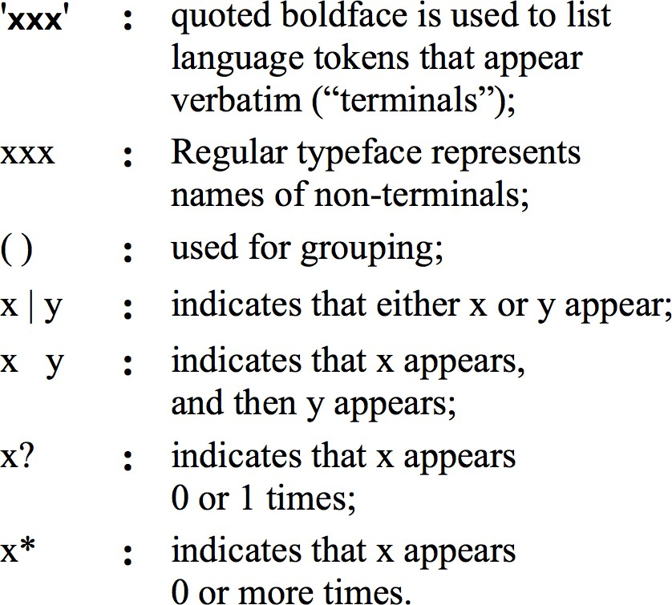
Grammar notation
statement: ifStatement |
whileStatement | letStatement
statements: statement* ifStatement: 'if' '(' expression ')’
'{' statements '}’
whileStatement: 'while' '(' expression ')’
'{' statements '}’
letStatement: 'let' varName '=' expression ';' expression: term (op term)?
term: varName | constant varName: a string not beg. with a digit constant: a decimal number
op: '+' | '-' | '=' | '>' | '<'
Reference: http://nand2tetris.org
Nand to Tetris / www.nand2tetris.org / Chapter 6 / Copyright © Noam Nisan and Shimon Schocken

Slide 82
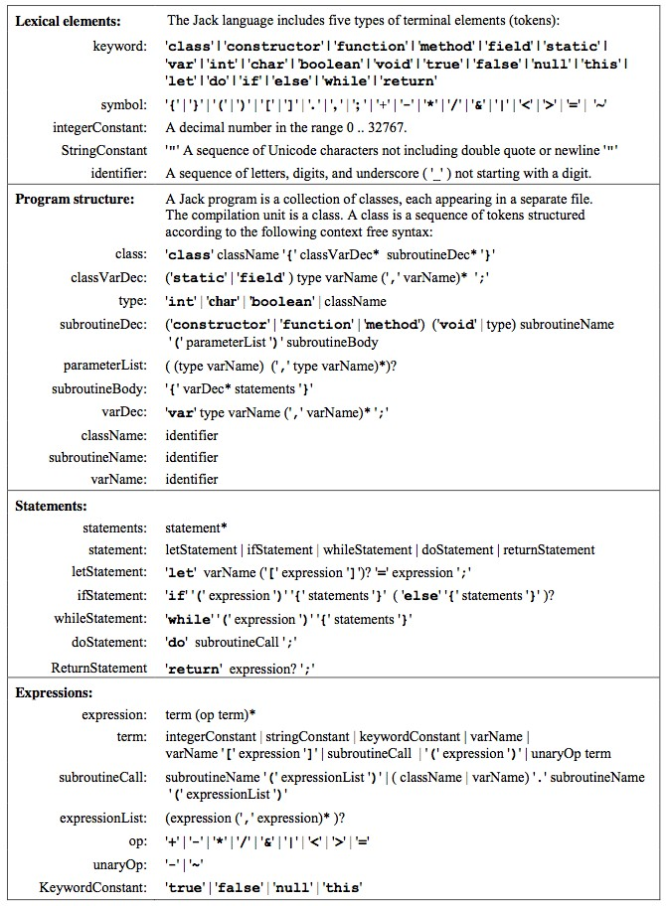
Jack grammar
Nand to Tetris / www.nand2tetris.org / Chapter 6 / Copyright © Noam Nisan and Shimon Schocken

Slide 83
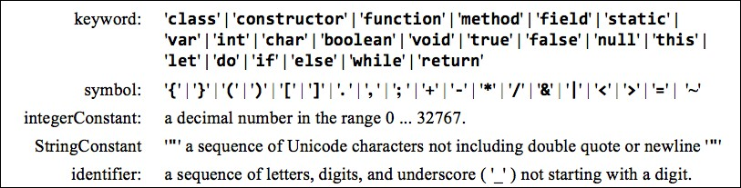
Jack grammar: lexical elements
The Jack language includes five categories of terminal elements (tokens):
Reference: http://nand2tetris.org
Nand to Tetris / www.nand2tetris.org / Chapter 6 / Copyright © Noam Nisan and Shimon Schocken

Slide 84
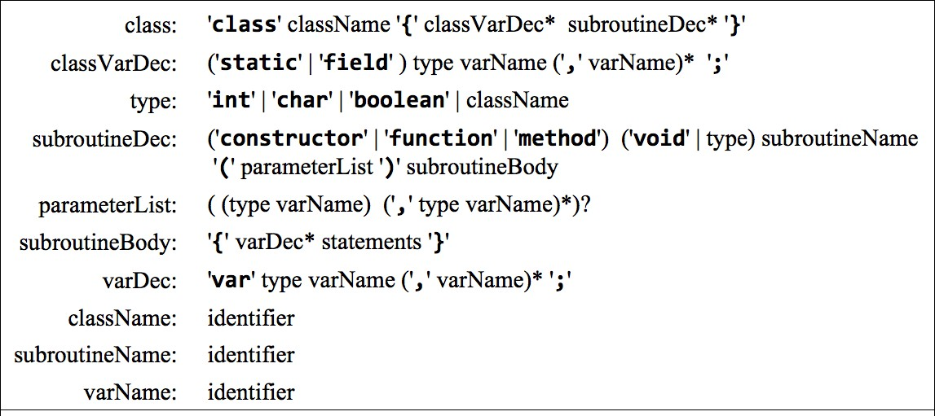
Jack grammar: program structure
A Jack program is a collection of classes, each appearing in a separate file, and each compiled separately. Each class is structured as follows:
Reference: http://nand2tetris.org
Nand to Tetris / www.nand2tetris.org / Chapter 6 / Copyright © Noam Nisan and Shimon Schocken

Slide 85
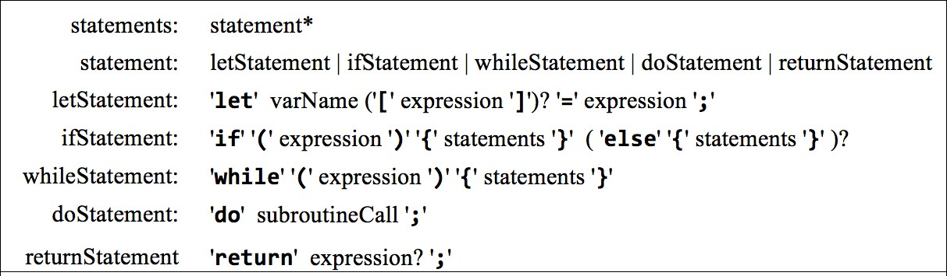
Jack grammar: statements
A Jack program includes statements, as follows:
Reference: http://nand2tetris.org
Nand to Tetris / www.nand2tetris.org / Chapter 6 / Copyright © Noam Nisan and Shimon Schocken

Slide 86
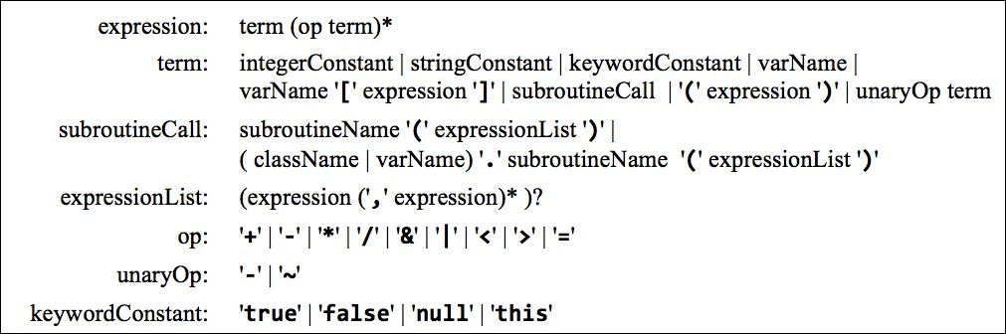
Jack grammar: expressions
A Jack program includes expressions, as follows:
Reference: http://nand2tetris.org
Nand to Tetris / www.nand2tetris.org / Chapter 6 / Copyright © Noam Nisan and Shimon Schocken

Slide 87
End note: parsing
Parser’s design
A set of compilexxx methods, structured according to the grammar rules defining xxx
Each method outputs some of the parse tree (XML), and advances the input
The parsing logic of each method follows the right-hand side of the rule that it implements.
Reference: http://nand2tetris.org
Nand to Tetris / www.nand2tetris.org / Chapter 10 / Copyri
ght © Noam Nisan and Shimon Schocken
Nand to Tetris / www.nand2tetris.org / Chapter 6 / Copyright © Noam Nisan and Shimon Schocken

Slide 88
End note: parsing expressions
Parser’s design
A set of compilexxx methods, structured according to the grammar rules defining xxx
Each method outputs some of the parse tree (XML), and advances the input
The parsing logic of each method follows the right-hand side of the rule that it implements.
Reference: http://nand2tetris.org
Nand to Tetris / www.nand2tetris.org / Chapter 10 / Copyri
ght © Noam Nisan and Shimon Schocken
Nand to Tetris / www.nand2tetris.org / Chapter 6 / Copyright © Noam Nisan and Shimon Schocken

Slide 89


End note: parsing expressions
When the current token is a varName (some identifier), it can be the first token in any one of these possibilities:
To resolve which possibility we are in, the parser should “look ahead”:
save the current token, and
advance to get the next one.
foo foo[expression]
foo.bar(expressionList)
Foo.bar(expressionList) bar(expressionList)
This is the only case in the Jack grammar in which the language becomes LL(2) rather than LL(1).
Nand to Tetris / www.nand2tetris.org / Chapter 6 / Copyright © Noam Nisan and Shimon Schocken

Slide 90
Compiler I / parsing: lecture plan
Parsing:
Parsing Jack programs
Overview
Tokenizer
Grammar
Parse trees
Parsing process
The Jack grammar
The Jack analyzer
Overview
Proposed implementation
Building the Jack Analyzer
Reference: http://nand2tetris.org
Nand to Tetris / www.nand2tetris.org / Chapter 6 / Copyright © Noam Nisan and Shimon Schocken

Slide 91


Compiler development roadmap
How can we unit-test that the analyzer “understands” the source code?
We can have it output the the source code in some structured way
Reference: http://nand2tetris.org
Nand to Tetris / www.nand2tetris.org / Chapter 6 / Copyright © Noam Nisan and Shimon Schocken

Slide 92




Jack analyzer
input
/** Represents a Point. */ class Point {
...
/** Returns the x value */ method int getx() {
return x;
XML output
<class>
<keyword> class </keyword>
<identifier> Point </identifier>
<symbol> { </symbol>
...
<subroutineDec>
<keyword> method </keyword>
<keyword> int </keyword>
<identifier> getx </identifier>
<symbol> ( </symbol>
<parameterList>
</parameterList>
<symbol> ) </symbol>
<subroutineBody>
<symbol> { </symbol>
<statements>
<returnStatement>
<keyword> return </keyword>
<expression>
<term>
<identifier> x </identifier>
</term>
</expression>
<symbol> ; </symbol>
</returnStatement>
</statements>
<symbol> } </symbol>
</subroutineBody>
</subroutineDec>
...
<symbol> } </symbol>
<class>
}
...
parser
}
The parser generates marked-up output
The mark up creates a textual parse tree
Generated according to the Jack grammar
Reference: http://nand2tetris.org
Nand to Tetris / www.nand2tetris.org / Chapter 10 / Copyright © Noam Nisan and Shimon Schocken
Nand to Tetris / www.nand2tetris.org / Chapter 6 / Copyright © Noam Nisan and Shimon Schocken

Slide 93
Jack grammar
Nand to Tetris / www.nand2tetris.org / Chapter 6 / Copyright © Noam Nisan and Shimon Schocken

Slide 94



Jack analyzer: handling inputs that correspond to terminal rules
If the parser encounters a terminalElement xxx of type
keyword, symbol, integer constant, string constant, or identifier,
the parser generates the output:
where terminalElement is:
keyword, symbol,
integerConstant, stringConstant,
identifier
<terminalElement>
xxx
</terminalElement>
Examples:
<keyword> method </keyword>
<symbol> { </symbol>
<integerConstant> 42 </integerConstant>
<stringConstant> xkcd </stringConstant>
<symbol> { </symbol>
Reference: http://nand2tetris.org
Nand to Tetris / www.nand2tetris.org / Chapter 6 / Copyright © Noam Nisan and Shimon Schocken

Slide 95




Jack analyzer: handling inputs that correspond to non-terminal rules
If the parser encounter a nonTerminal element of type class declaration, class variable declaration, subroutine declaration, parameter list, subroutine body, variable declaration, statements, let statement, if statement, while statement,
do statement, return statement, an expression, a term, or an expression list,
the parser generates the output:
where nonTerminal is:
class, classVarDec, subroutineDec, parameterList, subroutineBody, varDec; statements, LetStatement, ifStatement, whileStatement, doStatement, returnStatement; expression, term, expressionList
<nonTerminal>
Recursive output for the non-terminal body
</nonTerminal>
Example: if the input is return x;
<returnStatement>
<keyword>
return
</keyword>
<expression>
<term>
<identifier> x </identifier>
</term>
</expression>
<symbol> ; </symbol>
</returnStatement>
Reference: http://nand2tetris.org
Nand to Tetris / www.nand2tetris.org / Chapter 6 / Copyright © Noam Nisan and Shimon Schocken

Slide 96




Jack analyzer: handling inputs that correspond to non-terminal rules
If the parser encounter a nonTerminal element of type type, class name, subroutine name, variable name, statement, or subroutine call,
The parser handles it directly, without recursing.
Example:
Jack grammar:
...
letStatement: 'let' varName '=' expression ';’ varName: identifier
identifier: a sequence of letters, digits, …, not starting with a digit
...
Suppose the input is let x = 17;
<letStatement>
<keyword> let </keyword>
<identifier> x </identifier>
<symbol> = </symbol>
<expression>
...
varName is handled directly
Nand to Tetris / www.nand2tetris.org / Chapter 10 / Copyright © Noam Nisan and Shimon Schocken
Nand to Tetris / www.nand2tetris.org / Chapter 6 / Copyright © Noam Nisan and Shimon Schocken

Slide 97
Compiler I / parsing: lecture plan
Parsing:
Parsing Jack programs
Overview
Tokenizer
Grammar
Parse trees
Parsing process
The Jack grammar
The Jack analyzer
Overview
Proposed implementation
Building the Jack Analyzer
Reference: http://nand2tetris.org
Nand to Tetris / www.nand2tetris.org / Chapter 6 / Copyright © Noam Nisan and Shimon Schocken

Slide 98
Compiler development roadmap
Implementation plan:
JackTokenizer
CompilationEngine
JackAnalyzer (top-most / main module)
Nand to Tetris / www.nand2tetris.org / Chapter 6 / Copyright © Noam Nisan and Shimon Schocken

Slide 99
JackAnalyzer: usage
prompt> JackAnalyzer input
Input: | fileName.jack: | name of a single source file, or
 | directoryName: | name of a directory containing one or more .jack source files
Output:
if the input is a single file:
fileName.xml
if the input is a directory: one .xml file for every .jack file,
stored in the same directory
Reference: http://nand2tetris.org
Nand to Tetris / www.nand2tetris.org / Chapter 6 / Copyright © Noam Nisan and Shimon Schocken

Slide 100
JackAnalyzer in action
Point.jack
/** Represents a Point. */ class Point {
...
/** Returns the x value */ method int getx() {
return x;
}
Point.xml
<class>
<keyword> class </keyword>
<identifier> Point </identifier>
<symbol> { </symbol>
...
<subroutineDec>
<keyword> method </keyword>
<keyword> int </keyword>
<identifier> getx </identifier>
<symbol> ( </symbol>
<parameterList>
</parameterList>
<symbol> ) </symbol>
<subroutineBody>
<symbol> { </symbol>
<statements>
<returnStatement>
<keyword> return </keyword>
<expression>
<term>
<identifier> x </identifier>
</term>
</expression>
<symbol> ; </symbol>
</returnStatement>
</statements>
<symbol> } </symbol>
</subroutineBody>
</subroutineDec>
...
<symbol> } </symbol>
<class>
...
JackAnalyzer
}
The JackAnalyzer
Uses the services of a JackTokenizer
Written according to the Jack grammar
Reference: http://nand2tetris.org
Nand to Tetris / www.nand2tetris.org / Chapter 10 / Copyright © Noam Nisan and Shimon Schocken
Nand to Tetris / www.nand2tetris.org / Chapter 6 / Copyright © Noam Nisan and Shimon Schocken

Slide 101
Jack grammar (guideline for writing the JackAnalyzer)
JackTokenizer
CompilationEngine
Nand to Tetri
s / www.nand2tetris.org / Chapter 10 / Copyright © Noam
Nand to Tetris / www.nand2tetris.org / Chapter 6 / Copyright © Noam Nisan and Shimon Schocken

Slide 102

JackAnalyzer
input
XML output
/** Represents a Point. */ class Point {
...
/** Returns the x value */ method int getx() {
return x;
}
<class>
<keyword> class </keyword>
<identifier> Point </identifier>
<symbol> { </symbol>
...
<subroutineDec>
<keyword> method </keyword>
<keyword> int </keyword>
<identifier> getx </identifier>
<symbol> ( </symbol>
<parameterList>
</parameterList>
<symbol> ) </symbol>
<subroutineBody>
<symbol> { </symbol>
<statements>
<returnStatement>
<keyword> return </keyword>
<expression>
<term>
<identifier> x </identifier>
</term>
</expression>
<symbol> ; </symbol>
</returnStatement>
</statements>
<symbol> } </symbol>
</subroutineBody>
</subroutineDec>
...
<symbol> } </symbol>
<class>
...
JackAnalyzer
}
Nand to Tetris / www.nand2tetris.org / Chapter 6 / Copyright © Noam Nisan and Shimon Schocken

Slide 103

JackTokenizer
input
XML output
/** Represents a Point. */ class Point {
...
/** Returns the x value */ method int getx() {
return x;
}
<keyword> class </keyword>
<identifier> Point </identifier>
<symbol> { </symbol>
...
tokens only
<keyword> method </keyword>
<keyword> int </keyword>
<identifier> getx </identifier>
<symbol> ( </symbol>
...
JackAnalyzer
}
<symbol> ) </symbol>
<symbol> { </symbol>
<keyword> return </keyword>
<identifier> x </identifier>
<symbol> ; </symbol>
<symbol> } </symbol>
...
<symbol> } </symbol>
Nand to Tetris / www.nand2tetris.org / Chapter 6 / Copyright © Noam Nisan and Shimon Schocken

Slide 104

JackTokenizer
input
XML output
/** Represents a Point. */ class Point {
...
/** Returns the x value */ method int getx() {
return x;
}
<keyword> class </keyword>
<identifier> Point </identifier>
<symbol> { </symbol>
...
tokens only
<keyword> method </keyword>
<keyword> int </keyword>
<identifier> getx </identifier>
<symbol> ( </symbol>
...
...
JackAnalyzer
}
Jack tokens:
JackTokenizer:
Handles the compiler’s input. Allows:
keyword: 'class' | 'constructor' | 'function' | 'method' | 'field' | 'static' | 'var' | 'int' | 'char' | 'boolean' | 'void' | 'true' | 'false' | 'null' | 'this' | 'let' | 'do' | 'if' | 'else' | 'while' | 'return’
symbol: '{' | '}' | '(' | ')' | '[' | ']' | '. ' | ', ' | '; ' | '+' | '-' | '*' | '/' | '&' | '|' | '<' | '>' | '=' | '~’
integerConstant: a decimal number in the range 0 ... 32767 StringConstant: '"' a sequence of Unicode characters,
not including double quote or newline '"'
identifier: a sequence of letters, digits, and
Ignoring white space
Advancing the input, one token at a time
Getting the value and type
of the current token
Reference: http://nand2tetris.org
underscore ( '_' ) not starting with a digit.

Slide 105
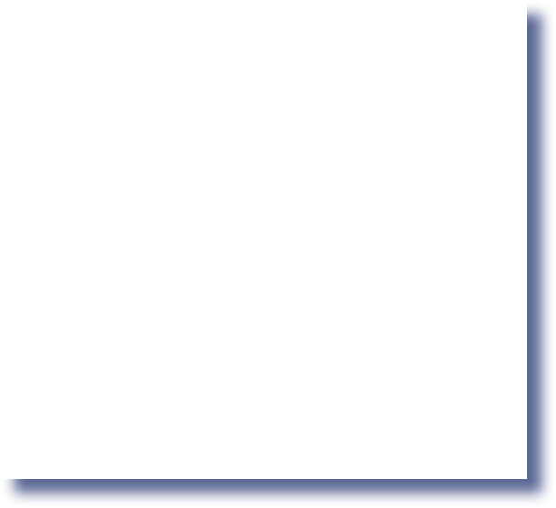

JackTokenizer
input
XML output
/** Represents a Point. */ class Point {
...
/** Returns the x value */ method int getx() {
return x;
}
<keyword> class </keyword>
<identifier> Point </identifier>
<symbol> { </symbol>
...
tokens only
<keyword> method </keyword>
<keyword> int </keyword>
<identifier> getx </identifier>
<symbol> ( </symbol>
...
...
JackAnalyzer
}
Jack tokens:
JackTokenizer
keyword: 'class' | 'constructor' | 'function' | 'method' | 'field' | 'static' | 'var' | 'int' | 'char' | 'boolean' | 'void' | 'true' | 'false' | 'null' | 'this' | 'let' | 'do' | 'if' | 'else' | 'while' | 'return’
symbol: '{' | '}' | '(' | ')' | '[' | ']' | '. ' | ', ' | '; ' | '+' | '-' | '*' | '/' | '&' | '|' | '<' | '>' | '=' | '~’
integerConstant: a decimal number in the range 0 ... 32767 StringConstant: '"' a sequence of Unicode characters,
not including double quote or newline '"'
identifier: a sequence of letters, digits, and underscore ( '_' ) not starting with a digit.
class JackTokenizer {
// Constructor (code omitted) hasMoreTokens() advance() tokenType()
...
}
Reference: http://nand2tetris.org
Nand to Tetris / www.nand2tetris.org / Chapter 10 / C

Slide 106
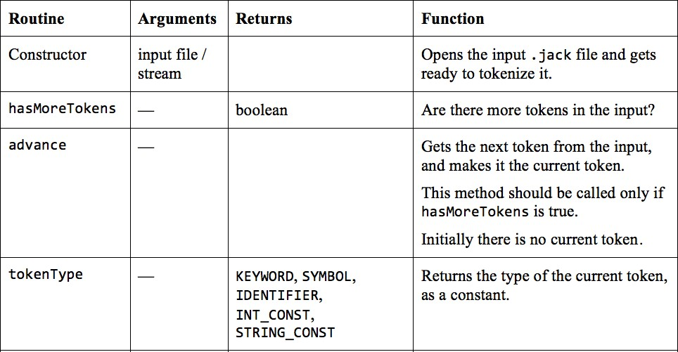
JackTokenizer API
Reference: http://nand2tetris.org
Nand to Tetris / www.nand2tetris.org / Chapter 6 / Copyright © Noam Nisan and Shimon Schocken

Slide 107
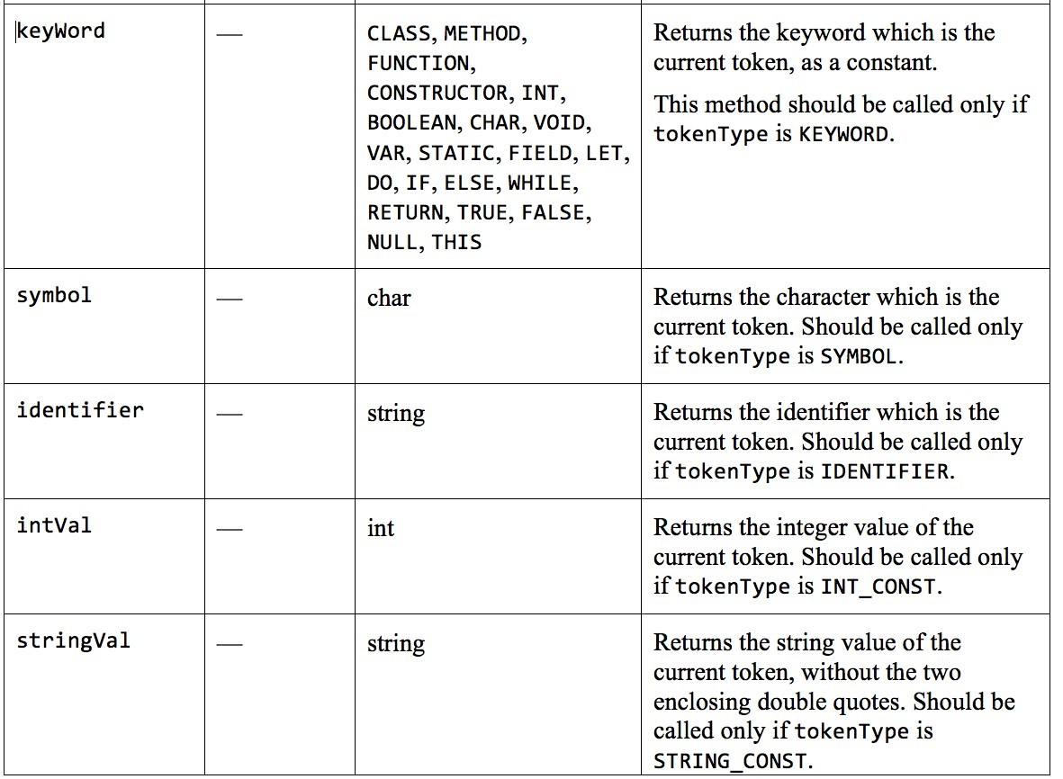
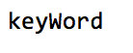
JackTokenizer API
Nand to Tetris / www.nand2tetris.org / Chapter 6 / Copyright © Noam Nisan and Shimon Schocken

Slide 108

Jack grammar
Tokenizer
CompilationEngine
Nand to Tetri

Slide 109




CompilationEngine design
Grammar CompilationEngine
...
statement:
class CompilationEngine {
// Constructor (code omitted)
compileStatements() {
// code for compiling statements
}
compileIfStatement() {
// code for compiling an if statement
}
compileWhileStatement() {
// code for compiling an while statement
}
...
}
ifStatement | whileStatement | letStatement | ...
statements:
statement*
ifStatement:
'if' '(' expression ')’
'{' statements '}’
'while' '(' expression ')’
'{' statements '}’
whileStatement:
…
Gets its input from a JackTokenizer, and emits its output to an output file
The output is generated by a series of compilexxx routines, structured according to the grammar rules that define xxx
Each compilexxx routine is responsible for handling all the tokens that make up xxx, advancing the tokenizer exactly beyond these tokens, and outputing the parsing of xxx
Nand to Tetris / www.nand2tetris.org / Chapter 6 / Copyright © Noam Nisan and Shimon Schocken

Slide 110
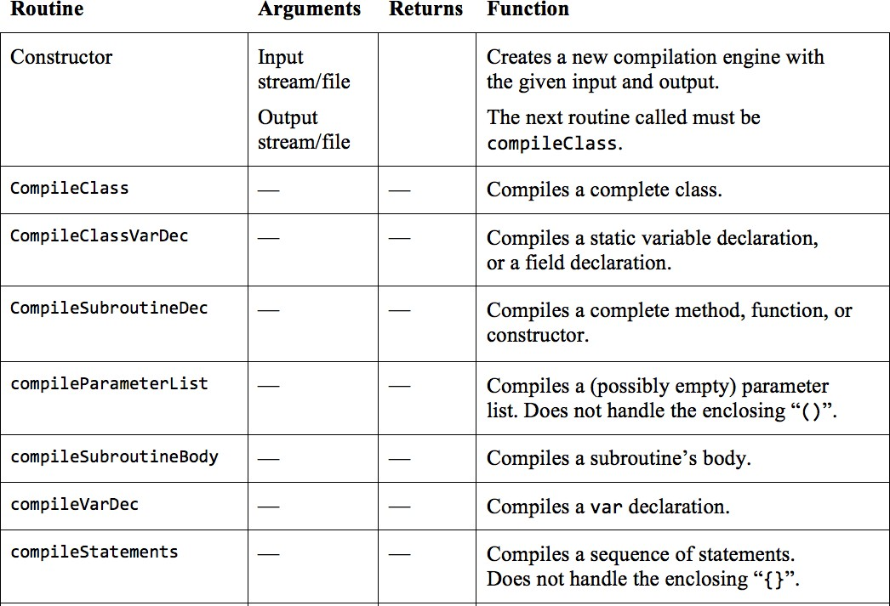
CompilationEngine API
CompilationEngine: generates the compiler’s output.
Reference: http://nand2tetris.org
Slide 110

Slide 111
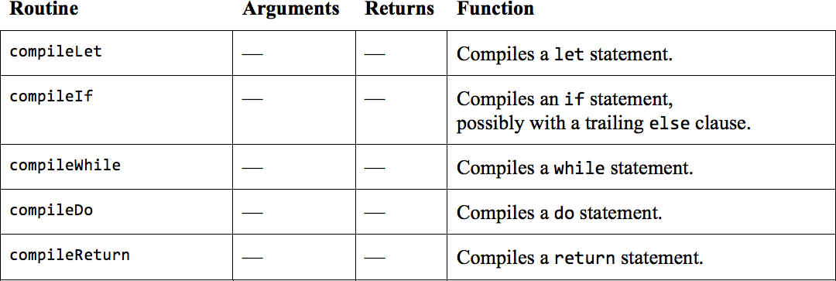
CompilationEngine API
CompilationEngine: generates the compiler’s output.
Reference: http://nand2tetris.org
Nand to Tetris / www.nand2tetris.org / Chapter 6 / Copyright © Noam Nisan and Shimon Schocken

Slide 112
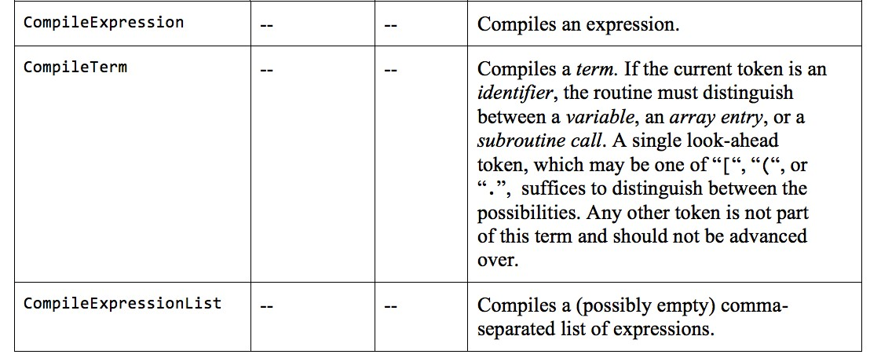
CompilationEngine API
CompilationEngine: generates the compiler’s output.
Reference: http://nand2tetris.org
Nand to Tetris / www.nand2tetris.org / Chapter 6 / Copyright © Noam Nisan and Shimon Schocken

Slide 113


CompilationEngine (end-note)
The following rules in the Jack grammar have no corresponding
compilexxx methods:
type
className
subroutineName
variableName
statement
subroutineCall
the parsing logic of these rules is handled by the rules that invoke them
Example:
compileStatements:
...
statement:
Uses a loop to handle 0 or more statement instances, according to the left-most token
If the left-most token is "if", "while",
...
it invokes compileIf, compileWhile, ...
There is no compileStatement method
ifStatement | whileStatement | letStatement | ...
statement*
'if' '(' expression ')’
'{' statements '}’
'while' '(' expression ')’
'{' statements '}’
statements: ifStatement:
whileStatement:
…

Slide 114

Recap
Implementation plan:
JackTokenizer
CompilationEngine
JackAnalyzer (top-most module)
Nand to Tetris / www.nand2tetris.org / Chapter 6 / Copyright © Noam Nisan and Shimon Schocken

Slide 115
JackAnalyzer
The top-most / main module
Input: a single fileName.jack, or a directory containing 0 or more such files
For each file, goes through the following logic:
Creates a JackTokenizer from fileName.jack
Creates an output file named fileName.xml
and prepares it for writing
Creates and uses a CompilationEngine to compile the input JackTokenizer
into the output file.
Reference: http://nand2tetris.org
Nand to Tetris / www.nand2tetris.org / Chapter 6 / Copyright © Noam Nisan and Shimon Schocken

Slide 116
Recap
Implementation plan:
JackTokenizer
CompilationEngine
JackAnalyzer (top-most module)
Nand to Tetris / www.nand2tetris.org / Chapter 6 / Copyright © Noam Nisan and Shimon Schocken

Slide 117
Compiler I / parsing: lecture plan
Parsing:
Parsing Jack programs
Overview
Tokenizer
Grammar
Parse trees
Parsing process
The Jack grammar
The Jack analyzer
Overview
Proposed implementation
Building the Jack Analyzer
Reference: http://nand2tetris.org
Nand to Tetris / www.nand2tetris.org / Chapter 6 / Copyright © Noam Nisan and Shimon Schocken

Slide 118
Goal: develop a syntax analyzer for the Jack language
Reference: http://nand2tetris.org
Nand to Tetris / www.nand2tetris.org / Chapter 6 / Copyright © Noam Nisan and Shimon Schocken

Slide 119
Goal: develop a syntax analyzer for the Jack language
Contract:
Implement a syntax analyzer for the Jack language
Use it to parse all the supplied test .jack class files
For each test .jack file, your analyzer should generate an .xml output file, identical to the supplied compare file.
Tools and resources:
Test programs and compare files: nand2tetris/projects/10
TextComparer: nand2tetris/tools
XML file viewer: browser, text editor, ...
Programming language: Java, Python, ...
Reference: chapter 10 in The Elements of Computing Systems
Nand to Tetris / www.nand2tetris.org / Chapter 6 / Copyright © Noam Nisan and Shimon Schocken

Slide 120
Implementation plan
Build a Jack Tokenizer
Build a compilation engine
(a Jack analyzer that makes use of the Tokenizer’s services):
Basic version
Complete version
Reference: http://nand2tetris.org
Nand to Tetris / www.nand2tetris.org / Chapter 6 / Copyright © Noam Nisan and Shimon Schocken

Slide 121




Jack tokenizer
TestClass.jack
TestClassT.xml
...
if (x < 0) {
let sign = "negative";
<tokens>
<keyword> if </keyword>
<symbol> ( </symbol>
<identifier> x </identifier>
<symbol> &lt; </symbol>
<integerConstant> 0 </integerConstant>
<symbol> ) </symbol>
<symbol> { </symbol>
<keyword> let </keyword>
<identifier> sign </identifier>
<symbol> = </symbol>
<stringConstant> negative </stringConstant>
<symbol> ; </symbol>
<symbol> } </symbol>
</tokens>
}
...
tokenizer
string constants are outputted without the double-quotes
<, >, ", and & are outputted as
&lt;, &gt;, &quot;, and &amp;
Implementation tips:
Implement the Tokenizer API (described earlier)
You may use class library services (e.g. for handling strings etc.)
Nand to Tetris / www.nand2tetris.org / Chapter 6 / Copyright © Noam Nisan and Shimon Schocken

Slide 122




Jack analyzer
TestClass.jack
TestClass.xml
...
<letStatement>
<keyword> let </keyword>
<identifier> x </identifier>
<symbol> = </symbol>
<expression>
<term>
<identifier> x </identifier>
</term>
<symbol> * </symbol>
<term>
<symbol> ( </symbol>
<expression>
<term>
<identifier> x </identifier>
</term>
<symbol> * </symbol>
<term>
<integerConstant> 1 </integerConstant>
</term>
</expression>
<symbol> ) </symbol>
</term>
</expression>
<symbol> ; </symbol>
</letStatement>
...
...
let x = x * (x + 1);
...
tokenizer
Implementation:
Build a basic CompilationEngine that handles everything except expressions
Add the handling of expressions
(we supply test files to unit-test both stages)
Nand to Tetris / www.nand2tetris.org / Chapter 6 / Copyright © Noam Nisan and Shimon Schocken

Slide 123
Sample test class file
projects/10/Square/Square.jack
class Square {
field int x, y; // location on the screen field int size; // The size of the square
...
// Increments the square size by 2. method void incSize() {
if (((y + size) < 254) & ((x + size) < 510)) {
do erase();
let size = size + 2; do draw();
}
return;
}
...
// Moves the square up by 2 pixels. method void moveUp() {
if (y > 1) {
do Screen.setColor(false);
do Screen.drawRectangle(x, (y + size) - 1, x + size, y + size); let y = y - 2;
do Screen.setColor(true);
do Screen.drawRectangle(x, y, x + size, y + 1);
}
return;
}
// More Square methods
}
Reference: http://nand2tetris.org
Nand to Tetris / www.nand2tetris.org / Chapter 10 / Copyright © Noam Nisan and Shimon S
chocken
Nand to Tetris / www.nand2tetris.org / Chapter 6 / Copyright © Noam Nisan and Shimon Schocken

Slide 124
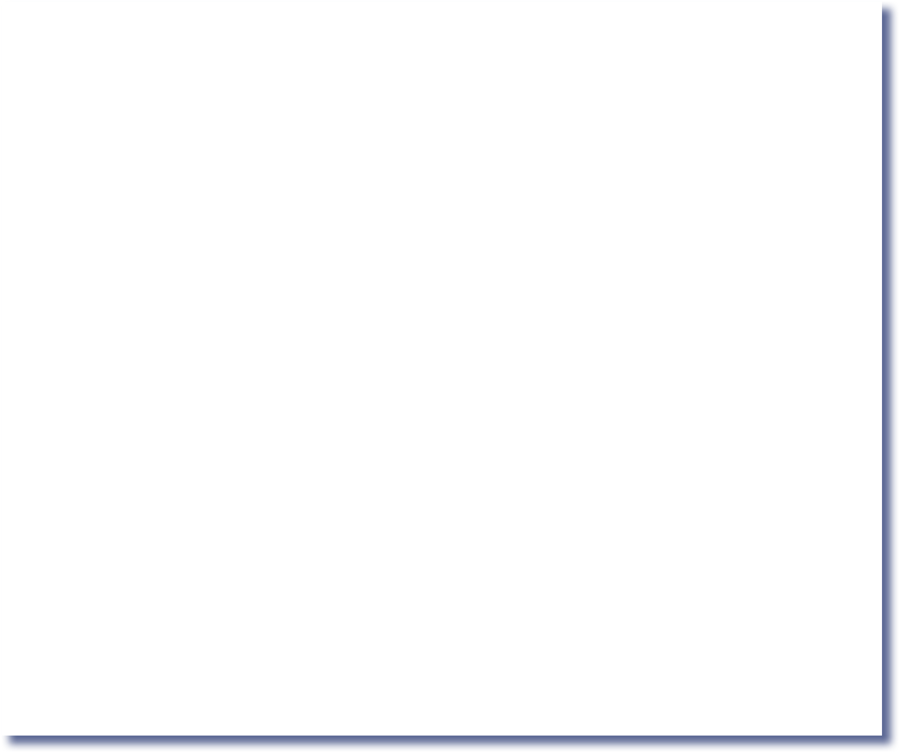
Sample test class file (expressions highlighted)
projects/10/Square/Square.jack
class Square {
field int x, y; // location on the screen field int size; // The size of the square
...
// Increments the square size by 2. method void incSize() {
if (((y + size) < 254) & ((x + size) < 510)) {
do erase();
let size = size + 2; do draw();
}
return;
}
...
// Moves the square up by 2 pixels. method void moveUp() {
if (y > 1) {
do Screen.setColor(false);
do Screen.drawRectangle(x, (y + size) - 1, x + size, y + size); let y = y - 2;
do Screen.setColor(true);
do Screen.drawRectangle(x, y, x + size, y + 1);
}
return;
}
// More Square methods
}
Reference: http://nand2tetris.org
Nand to Tetris / www.nand2tetris.org / Chapter 10 / Copyright © Noam Nisan and Shimon S
chocken
Nand to Tetris / www.nand2tetris.org / Chapter 6 / Copyright © Noam Nisan and Shimon Schocken

Slide 125

Sample test class file (expressionless version)
projects/10/Square/Square.jack projects/10/ExpressionLessSquare/Square.jack
class Square { class Square {
field int x, y; field int size;
...
// location
// The size
field int x, y; field int size;
...
// location on the screen
// The size of the square
on the screen
of the square
by 2.
(x + size) < 510)) {
ixels. e);
(x, (y + size) - 1, x + size, y + size);
);
(x, y, x + size, y + 1);
chocken
// Increments the square size method void incSize() {
if (((y + size) < 254) & (
do erase();
let size = size + 2; do draw();
}
return;
}
...
// Moves the square up by 2 p method void moveUp() {
if (y > 1) {
do Screen.setColor(fals do Screen.drawRectangle let y = y - 2;
do Screen.setColor(true do Screen.drawRectangle
}
return;
}
// More Square methods
// Increments the square size by 2. method void incSize() {
if (x) {
do erase();
let size = size; do draw();
Purpose:
tests the analyzer's ability to parse everything except expressions.
}
return;
}
...
// Moves the square up by 2 pixels. method void moveUp() {
if (y) {
do Screen.setColor(x);
do Screen.drawRectangle(x, y, x, y); let y = y;
do Screen.setColor(x);
do Screen.drawRectangle(x, y, x, y);
}
return;
}
// More Square methods
Reference: http://nand2tetris.org
}
}
Nand to Tetris / www.nand2tetris.org / Chapter 10 / Copyright © Noam Nisan and Shimon S
Nand to Tetris / www.nand2tetris.org / Chapter 6 / Copyright © Noam Nisan and Shimon Schocken

Slide 126




Basic Jack analyzer
Main.jack (expressionless)
Main.xml
...
<letStatement>
<keyword> let </keyword>
<identifier> x </identifier>
<symbol> = </symbol>
<expression>
<term>
<identifier> x </identifier>
</term>
</expression>
<symbol> ; </symbol>
</letStatement>
...
...
let x = x;
...
tokenizer
The expressionless code is meaningless, but is grammatically valid
Reference: http://nand2tetris.org
Nand to Tetris / www.nand2tetris.org / Chapter 6 / Copyright © Noam Nisan and Shimon Schocken

Slide 127

Implementation plan
Build a Jack Tokenizer
Build a compilation engine
(a Jack analyzer that makes use of the Tokenizer’s services):
Basic version (handles everything except expressions)
Complete version (handles everything)
Reference: http://nand2tetris.org
Nand to Tetris / www.nand2tetris.org / Chapter 6 / Copyright © Noam Nisan and Shimon Schocken

Slide 128
Remainder: handling expressions
When the current token is a varName (some identifier), it can be either a variable name, an array entry, or a subroutine call
To resolve which possibility we are in, the parser should “look ahead”: save the current token, and advance to get the next one.
Reference: http://nand2tetris.org
Nand to Tetris / www.nand2tetris.org / Chapter 6 / Copyright © Noam Nisan and Shimon Schocken

Slide 129
Remainder: handling expressions
When the current token is a varName (some identifier), it can be either a variable name, an array entry, or a subroutine call
To resolve which possibility we are in, the parser should “look ahead”: save the current token, and advance to get the next one
There is no compileSubroutineCall method;
rather, the subroutine call logic is handled in compileTerm
Nand to Tetris / www.nand2tetris.org / Chapter 6 / Copyright © Noam Nisan and Shimon Schocken

Slide 130
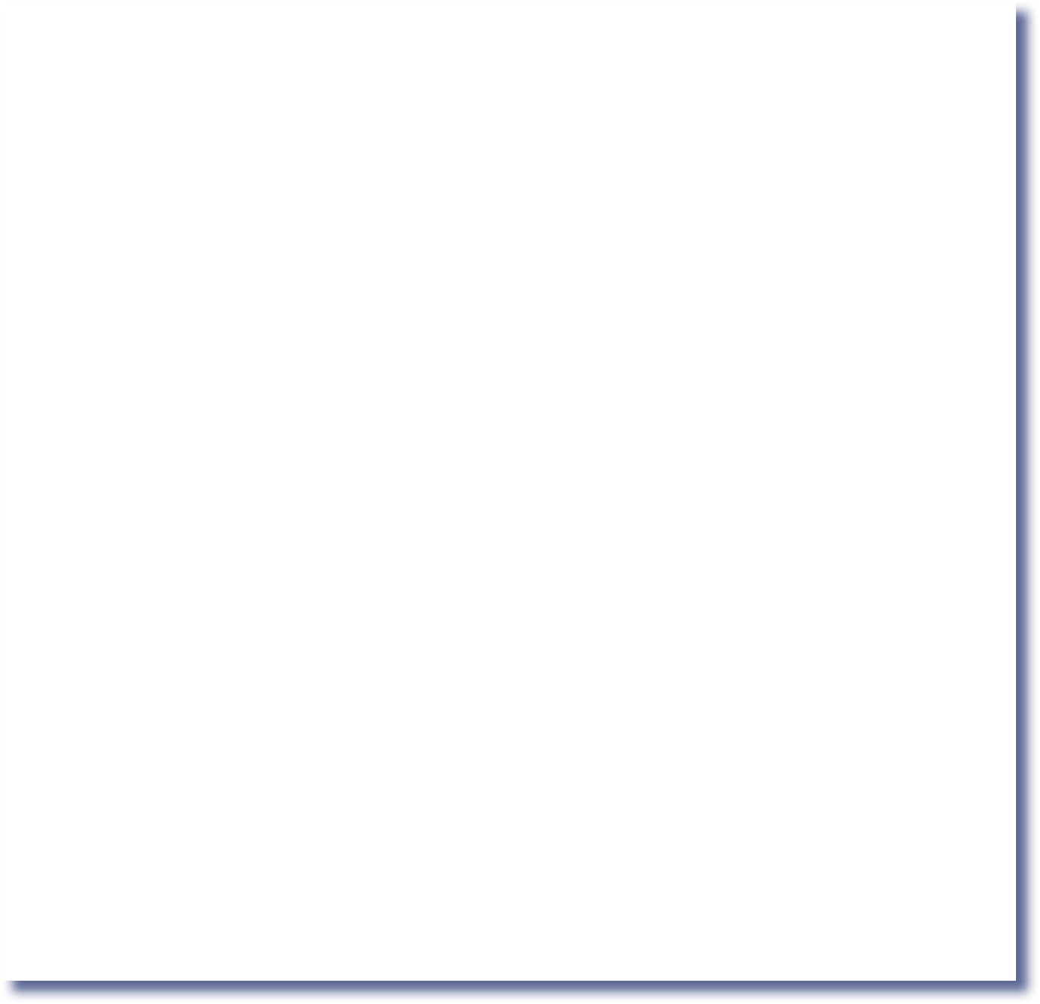

The ArrayTest class
Main.jack
/** Computes the average of a sequence of integers. */ class Main {
function void main() { var Array a;
var int length;
var int i, sum;
let length = Keyboard.readInt("HOW MANY NUMBERS? "); let a = Array.new(length);
let i = 0;
while (i < length) {
let a[i] = Keyboard.readInt("ENTER THE NEXT NUMBER: "); let i = i + 1;
}
let i = 0; let sum = 0;
while (i < length) {
let sum = sum + a[i]; let i = i + 1;
}
Purpose:
Tests the analyzer’s ability to handle array processing code.
do Output.printString("THE AVERAGE IS: "); do Output.printInt(sum / length);
do Output.println(); return;
}
}
Nand to Tetris / www.nand2tetris.org / Chapter 10 / Copyright © Noam Nisan a
Nand to Tetris / www.nand2tetris.org / Chapter 6 / Copyright © Noam Nisan and Shimon Schocken

Slide 131
Compiler’s development roadmap (project 10)
Reference: http://nand2tetris.org
Nand to Tetris / www.nand2tetris.org / Chapter 6 / Copyright © Noam Nisan and Shimon Schocken

Slide 132
Compiler’s development roadmap (project 11)
Reference: http://nand2tetris.org
Nand to Tetris / www.nand2tetris.org / Chapter 6 / Copyright © Noam Nisan and Shimon Schocken

Slide 133
Reference: http://nand2tetris.org
Nand to Tetris / www.nand2tetris.org / Chapter 6 / Copyright © Noam Nisan and Shimon Schocken

Slide 134
Reference: http://nand2tetris.org
Nand to Tetris / www.nand2tetris.org / Chapter 6 / Copyright © Noam Nisan and Shimon Schocken

Slide 135
Reference: http://nand2tetris.org
Nand to Tetris / www.nand2tetris.org / Chapter 6 / Copyright © Noam Nisan and Shimon Schocken

Slide 136
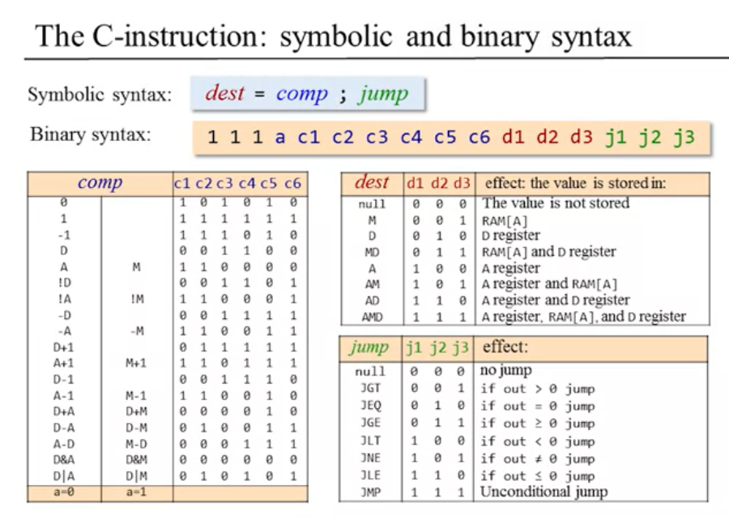

References:
https://www.nand2tetris.org/course
https://www.youtube.com/watch?v=KBTg0ju4rxM&list=PLrDd_kMiAuNmllp9vuPqCuttC1XL9VyVh
(see HDL Survival Guide @ www.nand2tetris.org)
Nand to Tetris / www.nand2tetris.org / Chapter 1 / Copyright © Noam Nisan and Shimon Schocken

